Slide 1
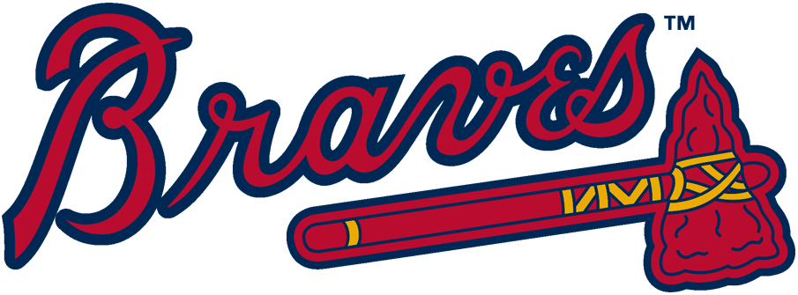
Take Me Out To A Braves Game: A Market Structure Mystery

Slide 2
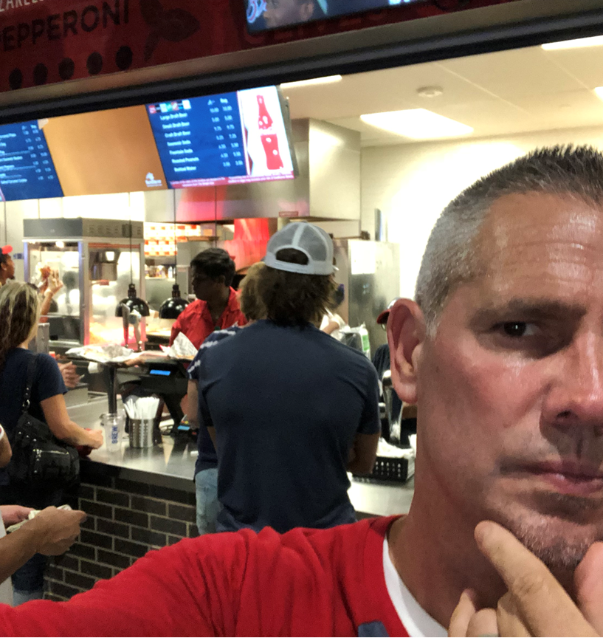
A Day at the Ballpark!
Popcorn
Classic (Cheese) Nachos
Domestic Beer
Soda (No Souvenir Cup)
Jumbo Hot Dog
Bottled Water (inside the stadium)
Bottled water (outside the stadium)
Foam tomahawk
Authentic Customized Jersey
Under Armor T-Shirt
Game Day Braves Parking Pass
Pizza (slice)
Dippin’ Dots (w/ souvenir helmet)
Upper Deck Vista Infield Tickets (Monday Game vs. Boston)
Upper Deck Vista Infield Tickets (Monday Game vs. Miami)
Dugout Infield Tickets (Monday Game vs. Boston)
Dugout Infield Tickets (Monday Game vs. Miami)
General Admission Tickets (Monday Game vs. Boston)
General Admission Tickets (Monday Game vs. Miami)
New Era Hat
$97.00
$5.50
$34.99
$16.00
$18.00
$9.00
$6.00
$175.00
$1.00
$5.00
$10.00
$38.00
$8.00
$231.00
$7.00
$35.00
$16.00
$5.00
$7.00
$3.00

Slide 3
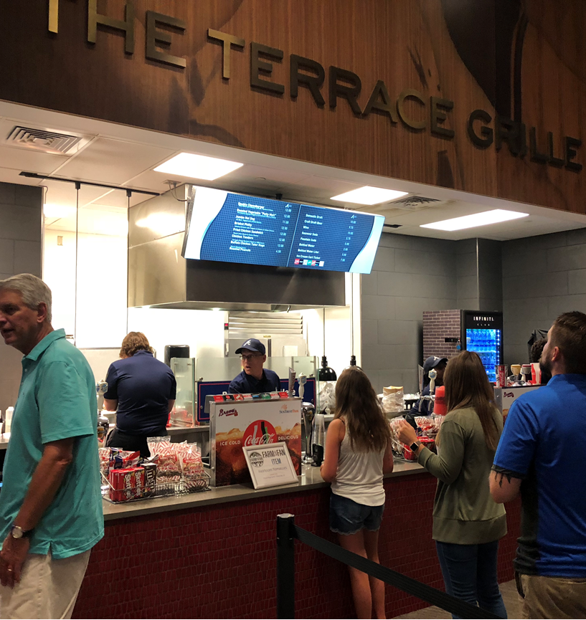
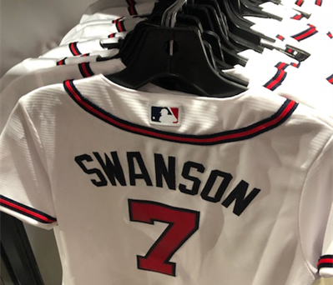
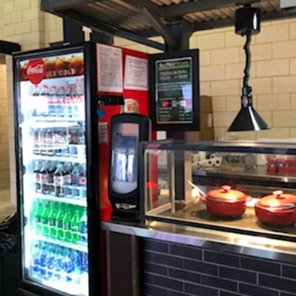
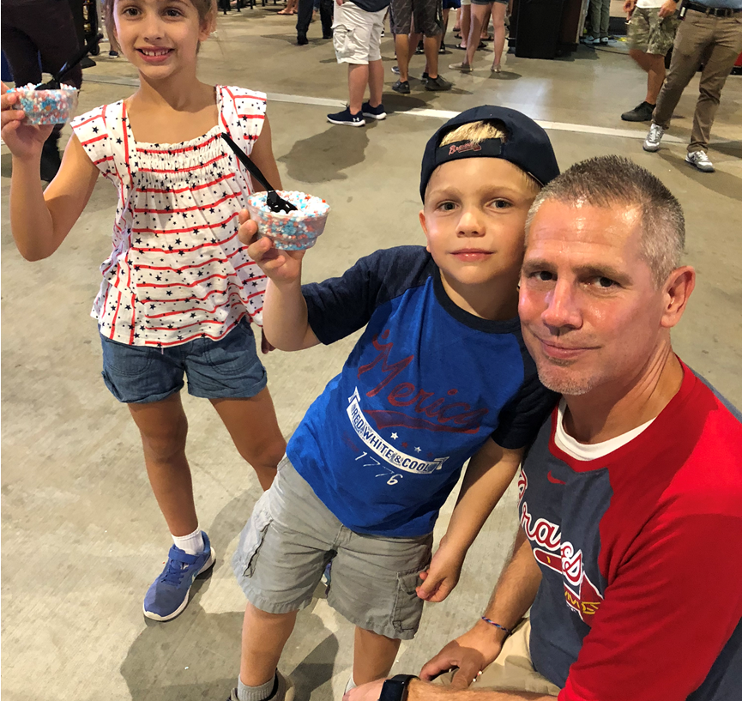
Key: A Day at the Ballpark!
Popcorn - G $6
Classic (Cheese) Nachos – J or R $5
Domestic Beer – K $10
Soda (No Souvenir Cup) - B $5.50
Jumbo Hot Dog - M $8
Bottled Water (inside the stadium) – T $3
Bottled water (outside the stadium) – I $1
Foam tomahawk – O or S $7.00
Authentic Customized Jersey – H $175
Under Armor T-Shirt – P $35
Game Day Braves Parking Pass (walking distance) – E $18
Pizza (slice) – O or S $7
Dippin’ Dots (w/ souvenir helmet) – F $9
Upper Deck Vista Infield Tickets (Monday Game vs. Boston) - L $38
Upper Deck Vista Infield Tickets (Monday Game vs. Miami) - D $16
Dugout Infield Tickets (Monday Game vs. Boston) - N $231
Dugout Infield Tickets (Monday Game vs. Miami) - A $97
General Admission Tickets (Monday Game vs. Boston) - D $16
General Admission Tickets (Monday Game vs. Miami) – J or R $5
New Era Hat – C $34.99

Slide 4
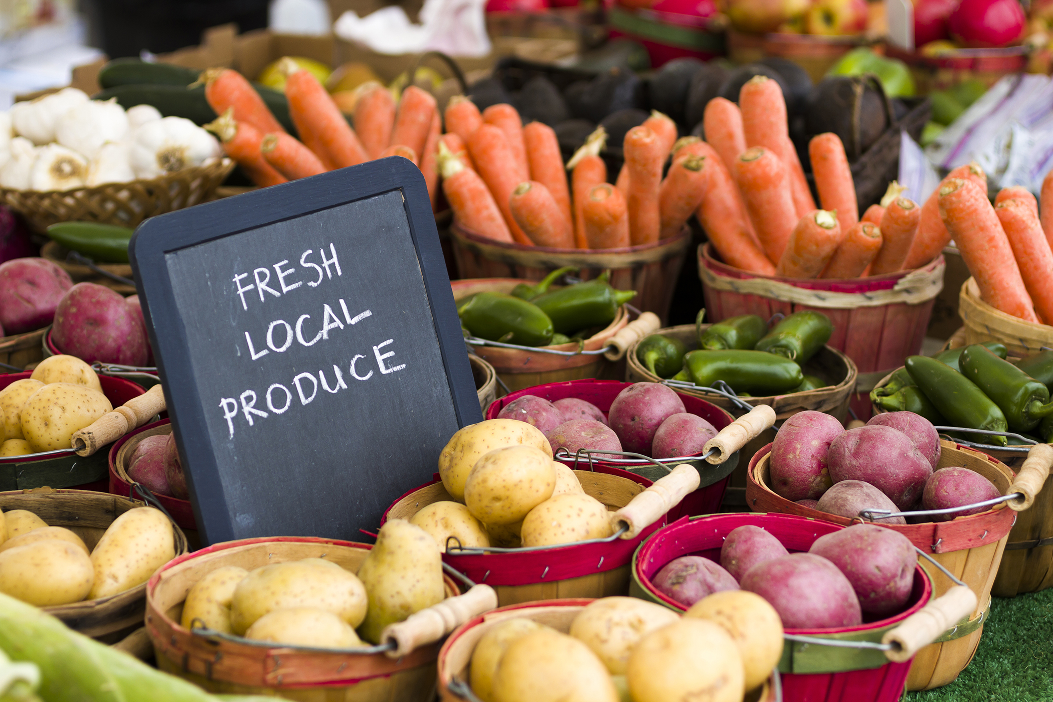
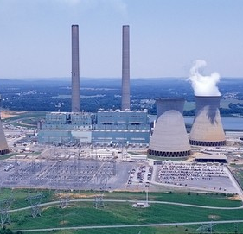
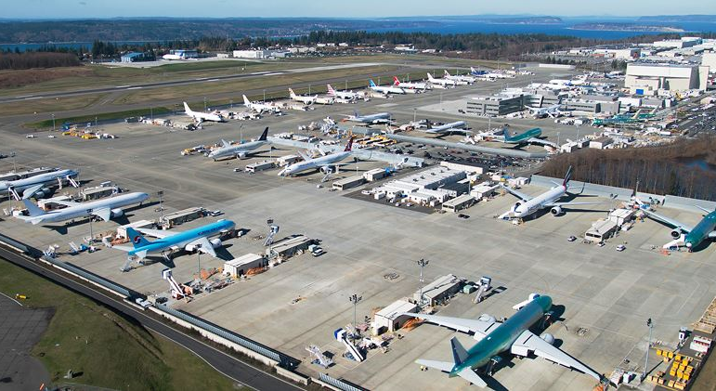
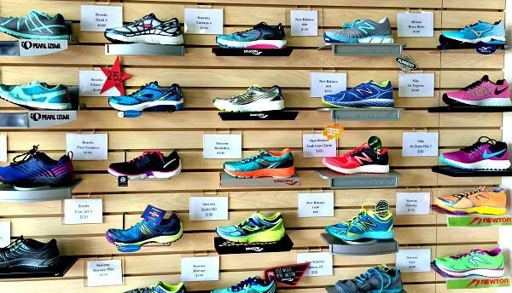
What Are The 4 Market Structures?
Perfect Competition
Monopolistic Competition
Oligopoly
Monopoly

Slide 5
Activity: Market Structure Matching
Each group will be given a blank Venn Diagram with a space for all 4 market structures.
1
Each group will also be given a set of “Market Element” cards that describe different elements of markets.
2
Your job is to place the appropriate cards in the left column of the market structure sheet with that characteristic.
3
Note: Remember, some elements may apply to more than one market structure and some will only apply to one structure
4

Slide 6
Perfect Competition
Monopolistic Competition
1000’s of firms
Identical products
Has no control over price
Low Barriers to Entry
100’s of firms
Differentiated products
Likely to advertise to increase sales
Profit Motive
Has control over price
Must lower price to increase quantity demanded
A few firms
Collusion/Cartels
Has control over price
Similar OR differentiated products
Takes other firms’ behaviors into consideration (Interdependence)
1 firm
Only firm in the industry
High barriers to entry
Oligopoly
Monopoly
Notes:
On-level Version

Slide 7
Perfect Competition
Monopolistic Competition
1000’s of firms
Identical products
Price Taker (Demand = MR)
Efficiency
Low Barriers to Entry
Normal Profits
100’s of firms
Excess capacity
Differentiated products
Profit Motive
Shut Down Rule
MR=MC
Price Maker (Demand > MR)
Deadweight loss
Must lower price to increase quantity demanded
A few firms
Collusion/Cartels
Price Maker (Demand > MR)
Game theory
Similar OR differentiated products
Takes other firms’ behaviors into consideration (Interdependence)
1 firm
Firm = Industry
Price discrimination
Potential for long-run economic profits
Deadweight loss
High barriers to entry
Oligopoly
Monopoly
Notes:
AP Version

Slide 8
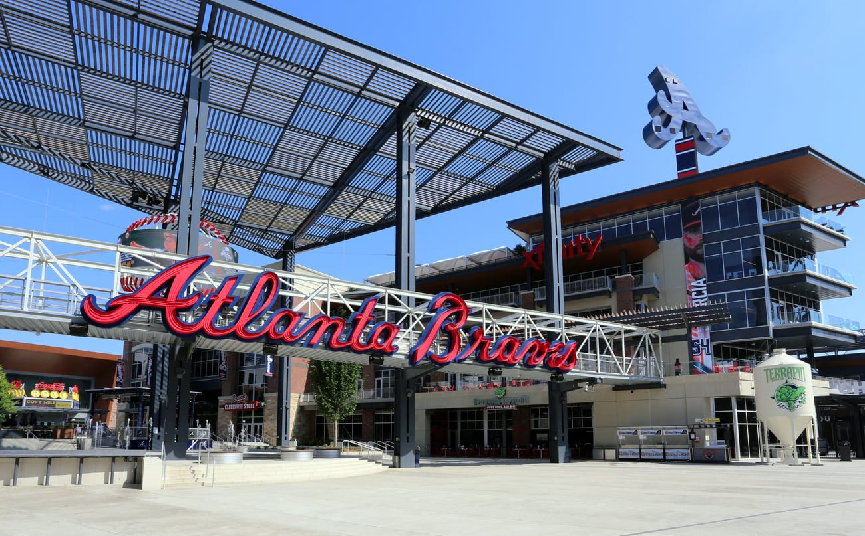
The Atlanta Braves: “A Microcosm of Markets”
We are going to use a visit to an Atlanta Braves game at Truist Park to try and find real world examples of the four market structures.
You will be given a variety of facts about products found at a Braves game.
You will take these facts and determine how they might fit into the market structures you just reviewed.
Place each fact into the correct quadrant of your market structure sheet, using the characteristics you identified as a guide.
For facts that seem contradictory or confusing, talk with your group as you try to match products to market structures

Slide 9
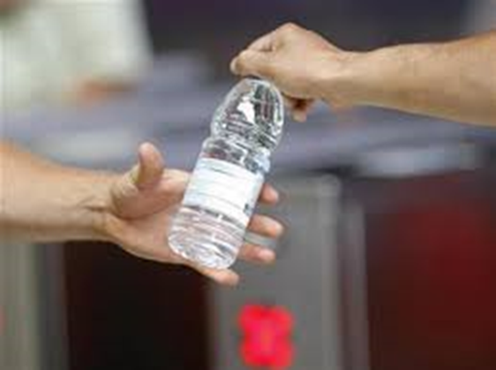
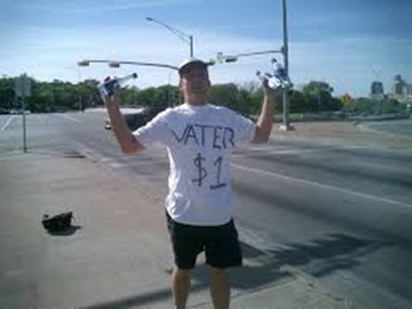
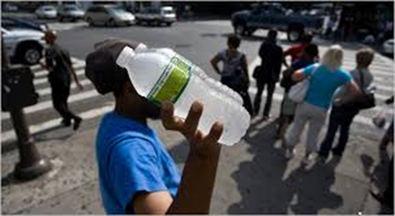
Truist Park Examples
Perfect competition:
Bottled water - specifically the market for bottle water outside the stadium.
Many small vendors
Independent products
Identically sized cold bottles of water.
Small inventories that are generally limited by the size of their coolers
Easy to join this market (bottled water is readily available and there are no real capital costs)
Limited differentiation (“ice cold”)
- ultimately there is very little distinction that consumers can make between vendors.
Vendors forced to sell at the same price.

Slide 10
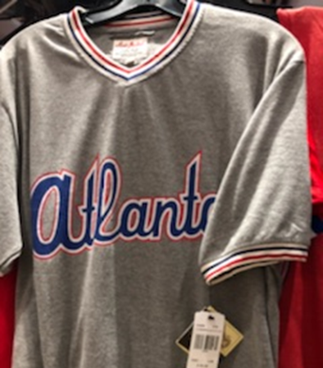
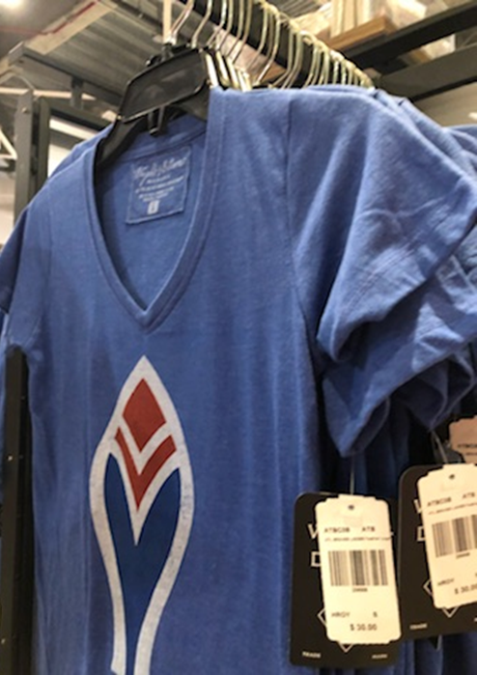
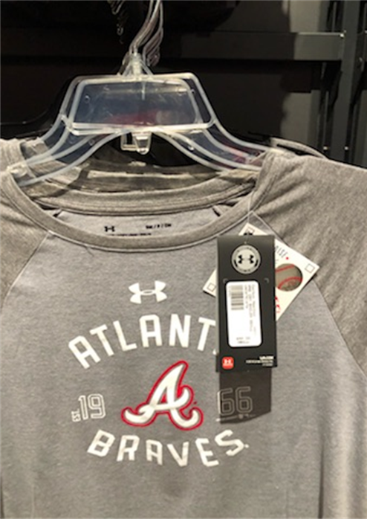
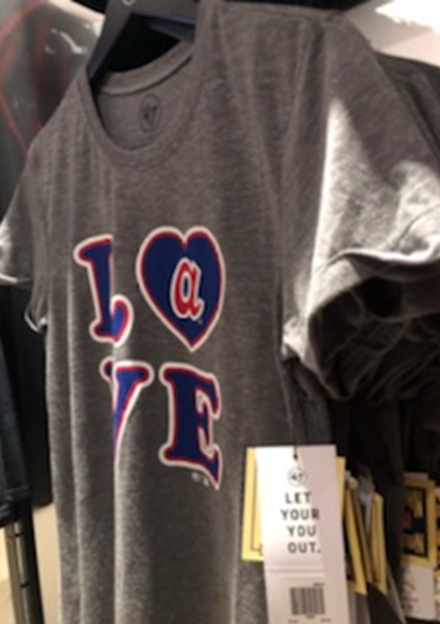
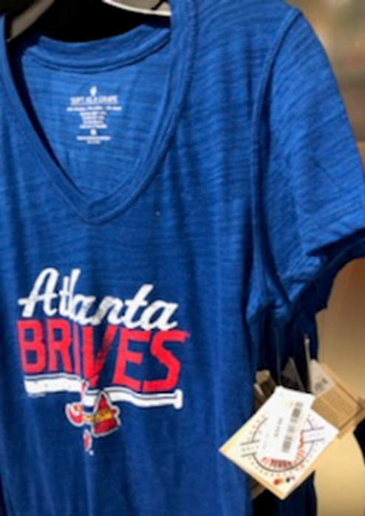
So What Did You Decide?
Monopolistic competition:
Market for apparel.
a number of sellers exist (think about sellers in this market as the company that produces the apparel rather than the physical location or vendor selling the apparel).
Some barriers to entry exist (licensing agreements, capital costs, economies of scale).
Great deal of product differentiation between and within brands (different logos, styles, colors, sizes, etc.)
Because of this, companies can charge a wide range of prices by appealing to consumer tastes and preferences.

Slide 11
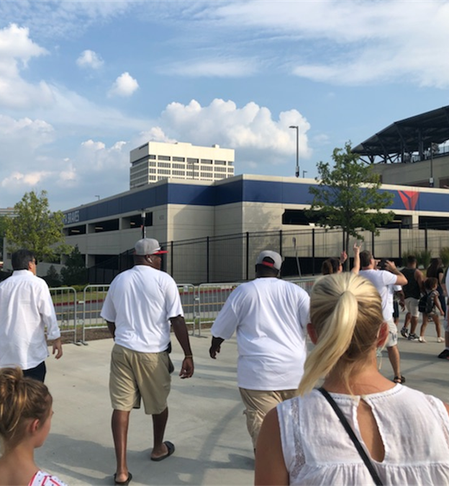
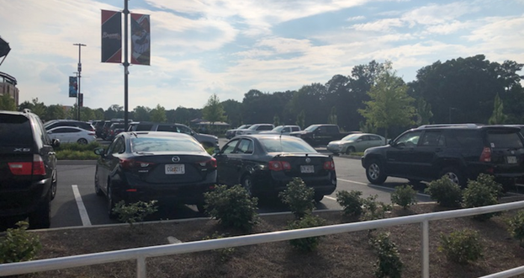
So What Did You Decide?
Oligopoly:
Market for parking.
Limited number of sellers
Fairly large barriers to entry (limited availability of physical space near Truist Park and the cost of that space).
Some market product differentiation between parking lots (based primarily on location, access, covered vs. uncovered parking, security, etc).
Accordingly, parking lots w/ different locations may charge different prices, but most lots within similar distances of the stadium must charge similar prices as competitors.
If prices/rates change, they tend to change for all similar locations.
Each parking lot pays attention to what other lots are charging.

Slide 12
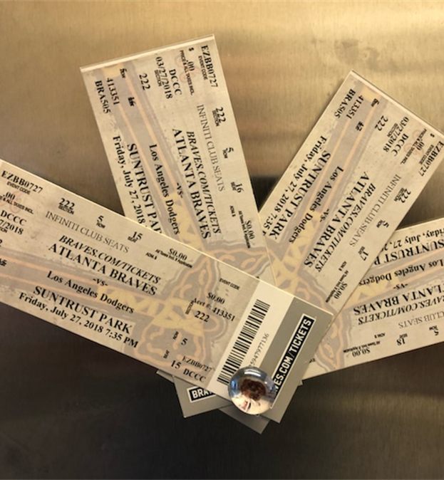
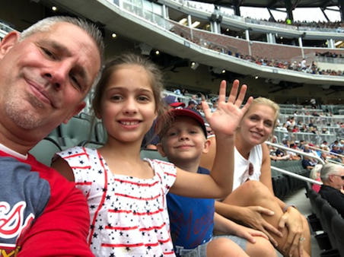
So What Did You Decide?
Monopoly:
Braves tickets.
Only one primary seller exists.
The Braves are the only Major League Baseball franchise in Georgia and the only company that can issue a ticket to a Braves game.
Due to constantly fluctuating demand for individual games, however, resellers do exist, but the Braves are still the original issuers of all tickets and set the market price.
Substantial barriers to entry (geography, franchise agreements with MLB, limited number of athletes available, price of a franchise/stadium).
No product differentiation - the Braves are the only MLB product in the market.
High degree of control over pricing, but still subject to the Law of Demand and must keep prices in mind when determining how many tickets they want to sell.

Slide 13
The following slides are optional and primarily designed for the AP Extension

Slide 14
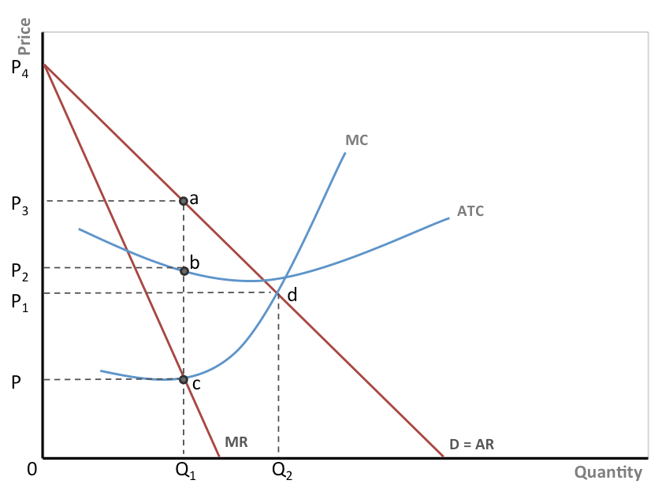
Optional AP Extension: Price Discriminating Monopolies and Dynamic Pricing
Range of possible prices
In certain cases, the monopolist can charge different prices to different buyers. This is known as price discrimination.
Perfect price discrimination allows the monopolist to charge each consumer the maximum amount he or she is willing to pay, thereby eliminating consumer surplus.
Graphically, this means that the MR curve no longer underlies the demand curve, as the monopolist does not have to lower the price for previous units sold when it lowers the price for a new buyer.
This creates a new MR=MC point at the point that appears to be the socially optimal point. While the monopolist then produces at the socially optimal quantity, he also eliminates consumer surplus.
Hence, there is no one price as each consumer pays a different price.
P_{SO}
MR curve becomes the demand curve

Slide 15
Three Important Requirements for Price Discrimination
The seller must have the ability to control market quantity and price (seems obvious – a price discriminating monopoly must actually BE a monopoly)
Can the Braves do this?
Yes, the Braves are the only MLB franchise in Georgia.
They have a geographic monopoly.
They can determine the number of tickets available
They have complete autonomy in setting the price of those tickets.

Slide 16
Three Important Requirements for Price Discrimination
The seller must be able to differentiate, or segregate, the market.
Can the Braves do this?
Yes. Much like airlines and hotels, the Braves can find ways to determine who is willing to pay more or less to see a game.
Traditionally, teams offer different prices for different seats.
Ticket prices can be as low as $5 for a general admission ticket or over $200 for the best seats.
This range lets consumers self-identify how much a braves ticket is worth to them and helps Braves minimize consumer surplus as each customer presumably pays close to his or her maximum price for a ticket.

Slide 17
Three Important Requirements for Price Discrimination
No resale! Otherwise a secondary market emerges that undermines the ability of the seller to price discriminate.
Can the Braves do this?
This is where it gets tricky. Unlike airlines or hotels, baseball tickets can be resold because teams do not require the person that is admitted to the game to be the person that purchased the ticket.
Also, in most states it is legal (with certain restrictions) to resell event tickets for more than the original value of the ticket, or its “face value”.
This means that if demand for a game is higher than the Braves anticipated, someone can resell an original ticket for more money.
This has led to the formation of an entire industry of resellers, with internet companies such as StubHub, Vividseats, and Tickpick.

Slide 18
So How Do the Braves Get Around This?
The answer is something called Dynamic Pricing
Teams have traditionally offered different prices for sitting in different parts of the stadium.
These prices are determined many months in advance and do not change throughout the season.
Variable Pricing came next and let teams charge different prices for different games based on factors like the day of the week or the traditional popularity of an opponent.
These prices were still determined far before the season
The newest development is called Dynamic Pricing. Now, thanks to technology, ticket prices can change literally right up to moments before the game.
Teams can price tickets in response to factors like weather, current sales, promotions, and opposing team records (teams can even adjust prices for attractive pitching matchups or if a player on one of the teams is accomplishing something significant, like a hitting streak or approaching a home run record).

Slide 19
Does This Fix The Problem?
Dynamic pricing and the secondary market
A response to the existence of a secondary market
Tickets sold at a fixed cost are vulnerable to changes in demand for different games.
Teams can lose money for higher demand games when resellers sell a ticket for more than face value.
Or when demand is less than anticipated, fans might be unwilling to pay a high prices and attendance drops.
Dynamic pricing responds to anticipated changes in demand.
So why does a secondary market still exist?
The Braves, and other sports teams, have a self-imposed price floor and ceiling.
They won’t charge a lower ticket price than the per-seat price they have offered their season ticket holders as it would undermine the value of season ticket packages.
They can’t set prices too high, even for games where demand is anticipated to be very high because teams are protective of the relationship between the team and its fans.
Charging too high a price could anger fans and damage this relationship.
Doesn’t apply to resellers since fans know they are simply a market for tickets and will charge the maximum price that demand allows.

Slide 20
Dynamic Pricing and Supply and Demand
Dynamic Pricing is not a substitute for the old-fashioned determinants of supply and demand. For example:
Winning matters!
An additional win for the home team (a demand shift) has roughly the same effect on quantity demanded as lowering ticket prices $1.09 across the entire stadium*.
Stadium occupancy matters!
1 percent increase in stadium occupancy (a demand shift) has the same effect on quantity demanded as a $3.47 drop in ticket prices across the entire stadium*.
Notes:
*https://www.forbes.com/sites/jimpagels/2015/02/24/dynamic-pricing-can-lower-ticket-revenues-if-misused/

Slide 21
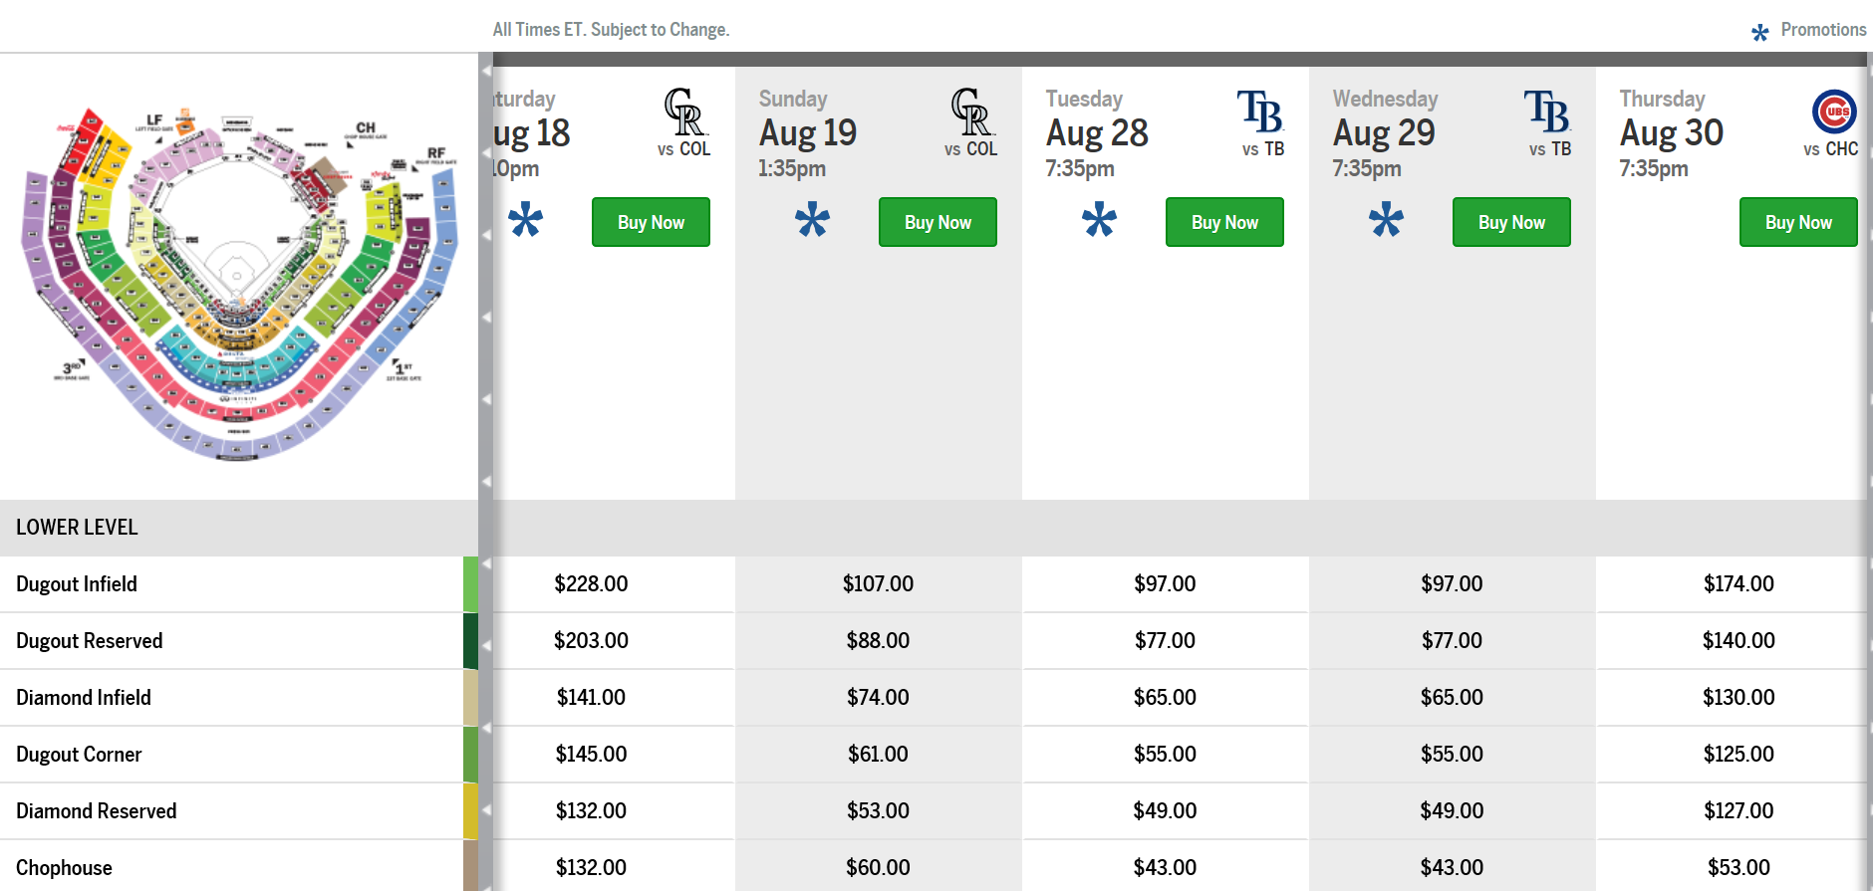
Dynamic Pricing
Why is a game against the Colorado Rockies more expensive than a game against the Chicago Cubs?
The Cubs traditionally draw some of largest crowds of the year, have a better record than the Rockies, have more star players, and lead their division.
Hint: a clue to the answer is contained in the screen shot.

Slide 22
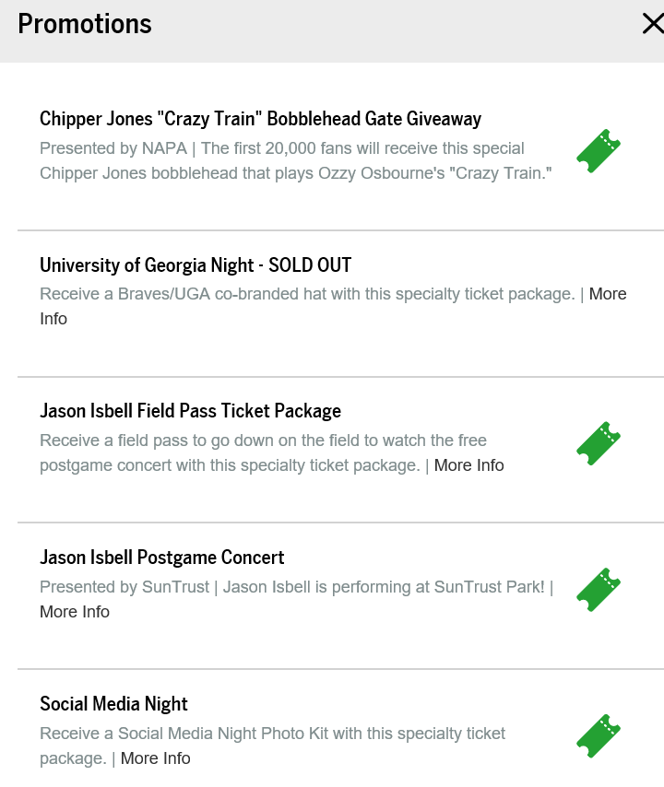
The answer can be found by clicking on the blue asterisk that identifies promotions that accompany each game. When we do that, we can see that the Braves are offering a Bobblehead doll of one of their most popular players and new Hall of Fame inductee, Chipper Jones. Additionally, it is University of Georgia night and there is a postgame concert. All of these factors lead the Braves to anticipate high demand for this game and allow them to raise ticket prices despite playing an opponent that is not traditionally a driver of attendance.

Slide 23
Optional AP Extension: Perfect Competition and Firm Price Control
What make an industry perfectly competitive?
Think about the vendors in the bottled water market, particularly the vendors outside the stadium that are selling their bottle for $1.⁰⁰.
Why can’t they control prices?
Perfect competition has identical or near identical products.
No way for consumer to differentiate the product from each other or express a meaningful preference.

Slide 24
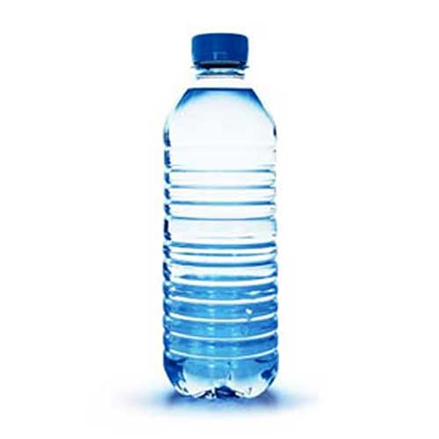
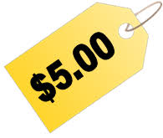
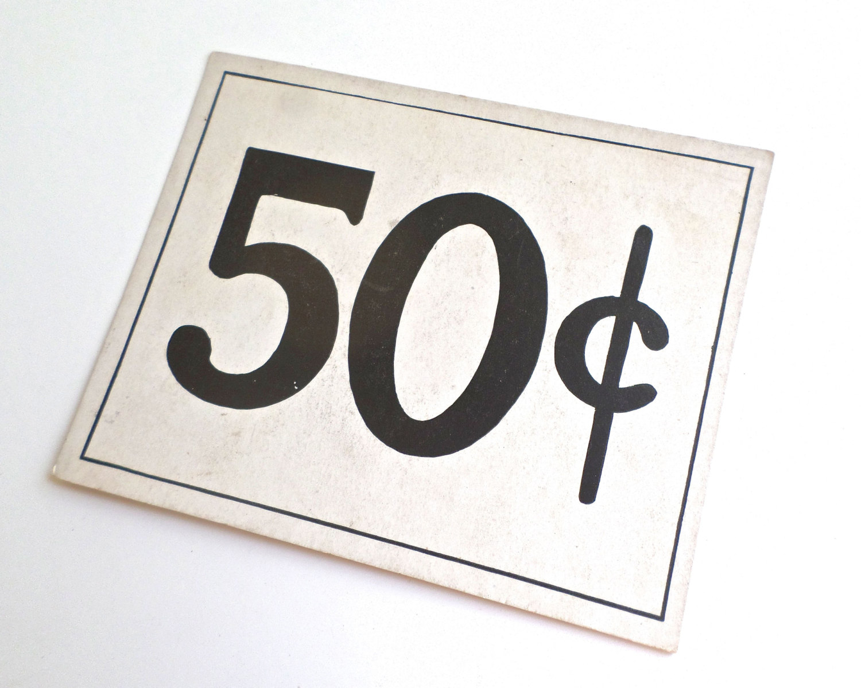
Optional AP Extension: Perfect Competition and Firm Price Control
So then what would happen if independent vendors tried to change the price of bottled water?
Picturing what would happen if the vendor tried to RAISE their prices is usually easy . . .
Consumers would just purchase the water from one of the many vendors selling water for less.
But why wouldn’t the vendor want to lower their prices to capture a bigger segment of the market and increase their sales? Any guesses?
Hint: picture the bottled water vendors. Where do they keep their water? How do they get it there? How do they keep it cold?
Answer: Each vendor is only able to transport, store, and keep cold a limited number of waters.
We can assume at the market price that all vendors are coming close to selling all of their water each game.
Individual vendors can’t supply water to all the fans at the game.
At lower prices they would still sell the same amount of water for a smaller total revenue and profit.
Applies to other models of perfect competition, like small producers at a farmers’ market.
Explains why perfectly competitive firms are termed “price takers”.

Slide 25
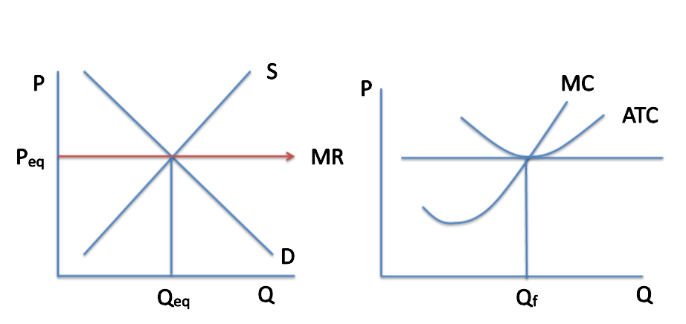
How does it look on a graph?
As we look at the side by side graphs above, we can make the following assumptions:
If the independent producer raises his or her price, demand does not just diminish. Rather, it goes to zero as all consumers choose existing vendors who are selling at lower prices.
The independent producer has no incentive to lower his or her price because they can sell all the want at the current prices
Only changes in the overall market (the graph on the left) can cause a change in price for the firm.

