Slide 1
Your Health Triangle

Slide 2
Today’s Learning Target
To be able to describe the relationship between health and
wellness!

Slide 3
Part 1

Slide 4
Label your paper
My Health Triangle
Physical Health
1.)
2.)
3.)
4.)
5.)
6.)

Slide 5
For each statement that follows answer YES or NO on your
paper depending upon whether the statement is true for you.

Slide 6
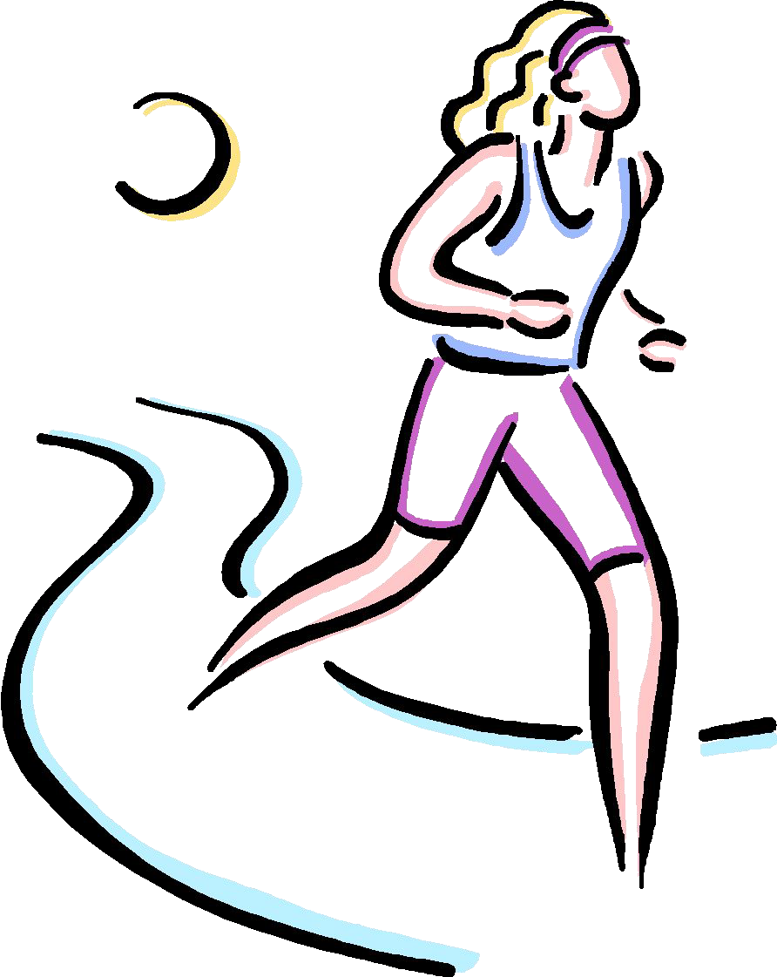
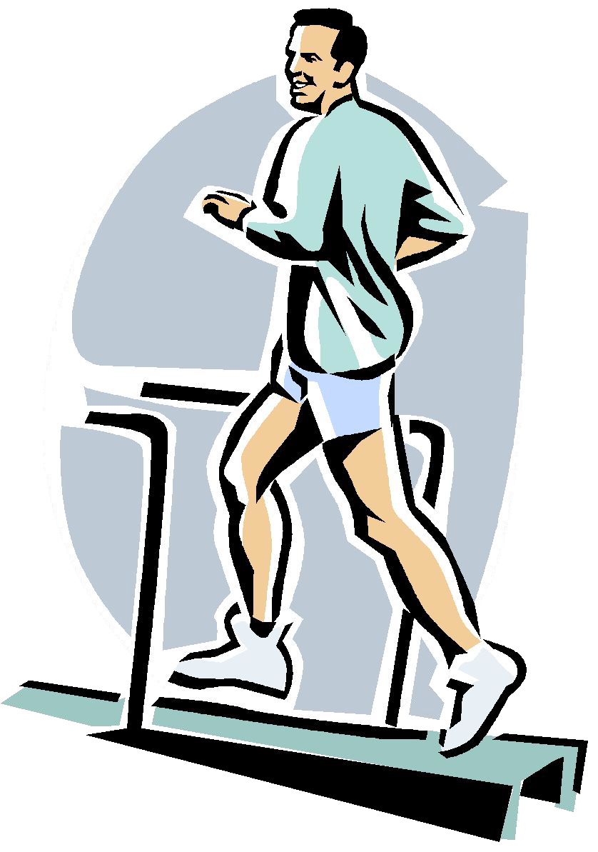
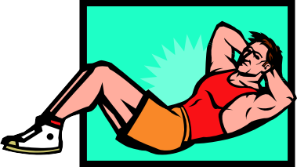
Physical Health
1.) I get at least eight hours of sleep each night.

Slide 7
Physical Health
2.) I eat a well balanced diet, including a healthful breakfast each day.

Slide 8
Physical Health
3.) I keep my body, teeth, and hair clean.

Slide 9
Physical Health
4.) I do at least 60 minutes of moderate physical activity each day.

Slide 10
Physical Health
5.) I avoid using tobacco, alcohol, and other drugs

Slide 11
Physical Health
6.) I see a doctor and dentist for regular checkups.

Slide 12
Part 2

Slide 13
Label your paper
My Health Triangle
Mental/Emotional Health
1.)
2.)
3.)
4.)
5.)
6.)

Slide 14
For each statement that follows answer YES or NO on your
paper depending upon whether the statement is true for you

Slide 15
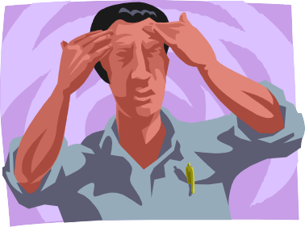
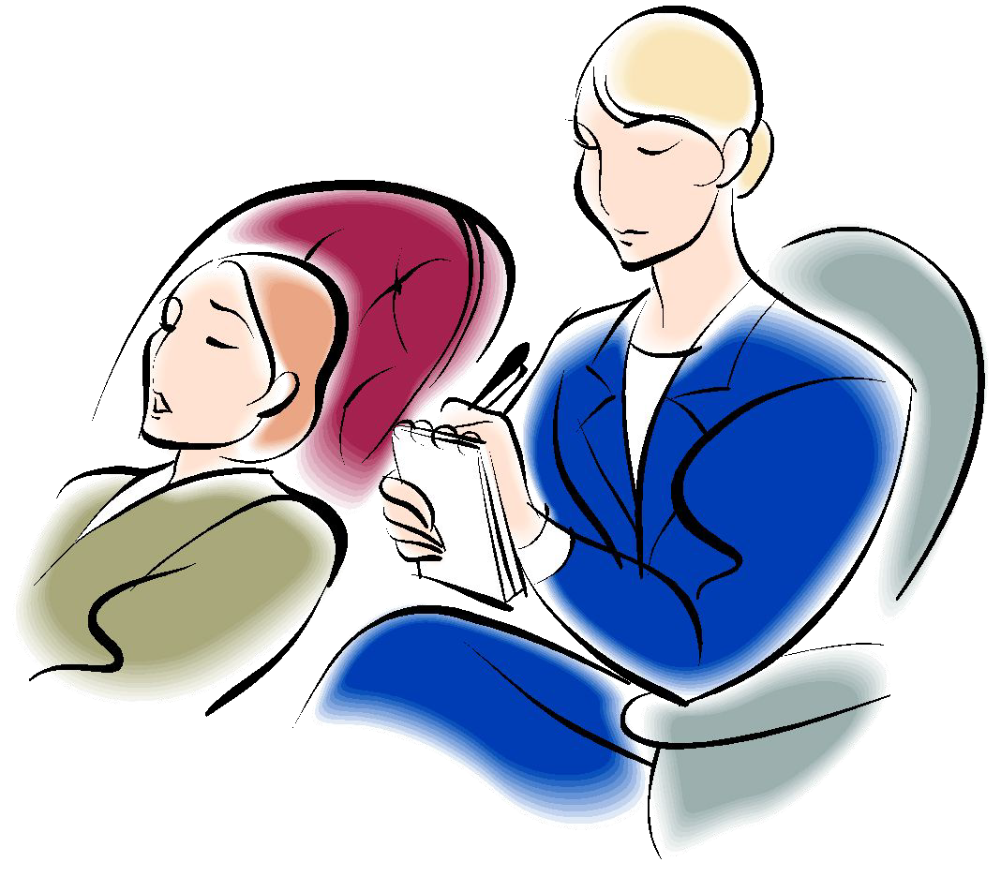
Mental/Emotional Health
1.) I generally feel good about myself and accept who I am.

Slide 16
Mental/Emotional Health
2.) I express my feelings clearly and calmly, even when I am angry
or sad.

Slide 17
Mental/Emotional Health
3.) I accept helpful criticism.

Slide 18
Mental/Emotional Health
4.) I have at least one activity that I enjoy.

Slide 19
Mental/Emotional Health
5.) I feel like people like and accept me.

Slide 20
Mental/Emotional Health
6.) I like to learn new information and develop new skills.

Slide 21
Part 3

Slide 22
Label your paper
My Health Triangle
Social Health
1.)
2.)
3.)
4.)
5.)
6.)

Slide 23
For each statement that follows answer YES or NO on your
paper depending upon whether the statement is true for you

Slide 24
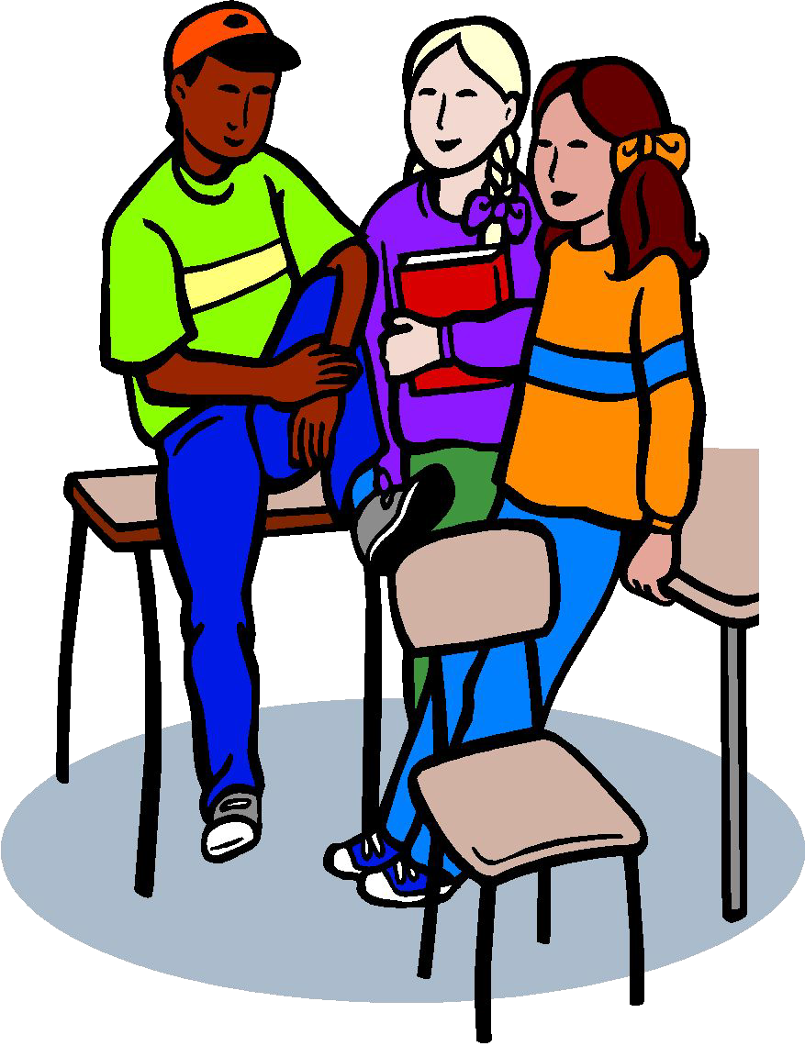
Social Health
1.) I have at least one close friend.

Slide 25
Social Health
2.) I respect and care for my family.

Slide 26
Social Health
3.) I know how to disagree with others without getting angry.

Slide 27
Social Health
4.) I am a good listener.

Slide 28
Social Health
5.) I get support from others when I need it.

Slide 29
Social Health
6.) I say no if people ask me to do something harmful or wrong.

Slide 30
Part 4

Slide 31
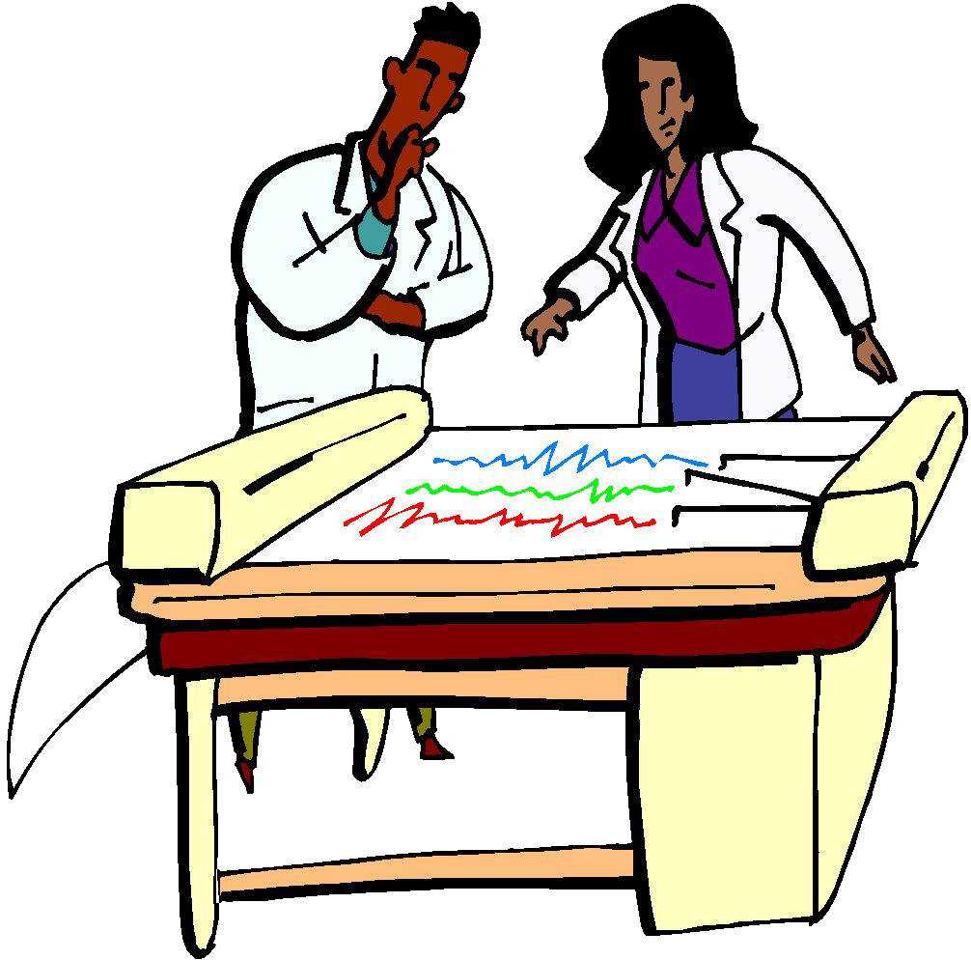
Analyzing Your Results
On your sheet of paper, you will draw a triangle that will allow you
to see if your health triangle is balanced or unbalanced.

Slide 32
Analyzing Your Results
Using a ruler and the scale below, draw your Health Triangle!
1 in = 1 yes answer

Slide 33
Analyzing Your Results
For example, if you answered 3 of the questions in the physical health section with “yes”, then you would draw a line that is 3
inches long!

Slide 34
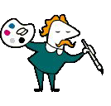
Analyzing Results
Draw all three sides of your triangle according to the scale!

Slide 35
Illustrating your Triangle
Within each of the three sections of your triangle, draw a picture that represents the questions you said
“yes” to. Label them as well!

Slide 36
Reflect on your Triangle
On the back of your paper, write a paragraph describing your Triangle.
Explain your strengths and weaknesses in each area (physical, emotional, social).
Describe how you will maintain or improve your Triangle.

Slide 37
Part 5

Slide 38
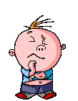
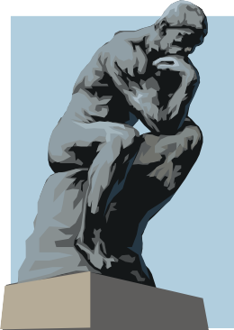
Think about it?
1.) Does your Health Triangle have equal sides?
2.) Is there one area that you are strong in?
3.) Is there an area that you need to work on?

Slide 39
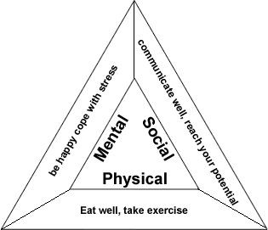
The Health Triangle
Health is the measure of our body’s efficiency and over-all well-being.
The health triangle is a measure of the different aspects of health.
The health triangle consists of: Physical, Social, and Mental Health.

Slide 40
Physical Health
Physical health deals with the body’s ability to function.
Physical health has many components including: exercise, nutrition, sleep, alcohol & drugs, and weight management.

Slide 41
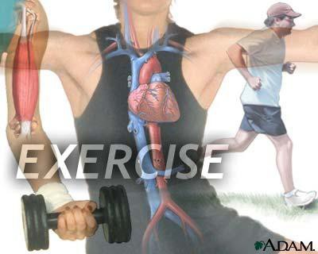
Physical Health Exercise
Exercise is the act of using your muscles to stay physically fit.
Exercise helps to give you more energy, maintain weight, increase confidence & self esteem, and helps to battle chronic diseases.

Slide 42
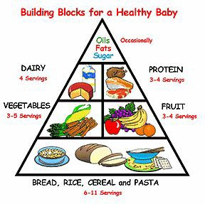
Physical Health Nutrition
Proper balanced meals are essential in leading a healthy life.
Nutritious meals create a balance between what we eat and the way our body uses the food for energy and growth.

Slide 43
Physical Health Sleep
It is recommended that the average person get at least 8 hours of sleep.
The human body likes regularity, so try to go to bed and wake up at the same time daily.

Slide 44
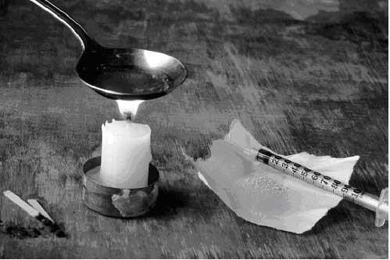
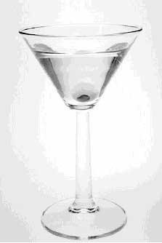
Physical Health Alcohol & Drugs
Alcohol and other drugs interfere with messages to the brain and alters perception.
Use of such substances puts you at risk for accidental injuries, car crashes, trouble with the law, unwanted pregnancies, and fights.

Slide 45
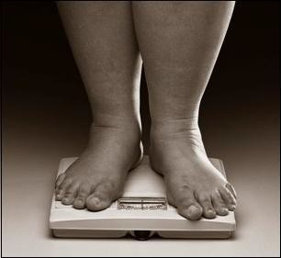
Physical Health Weight Management
Maintaining a healthy weight decreases your risk of certain diseases such as heart disease and diabetes.
Exercise and proper nutrition helps to maintain healthy weight levels.

Slide 46
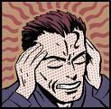
Mental Health
Mental heath deals with how we think, feel and cope with daily life.
Mental health encompasses learning, stress management, and mental illnesses or disorders.

Slide 47
Mental Health Learning
Learning is the development of skills, behaviors, and knowledge.
Learning increases self-confidence, awareness, and self perception. It also teaches one coping skills.

Slide 48
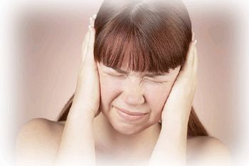
Mental Health Stress Management
Stress deals with the way our bodies and minds deal with life changes.
It is important to learn healthy ways to deal with stress or you could be at risk for anxiety or depression.

Slide 49
Mental Health Mental Disorders
Stress and problems with school, friends, and family can cause mental illnesses.
Mental illnesses include: depression, bipolar disorder, schizophrenia, and phobias.

Slide 50
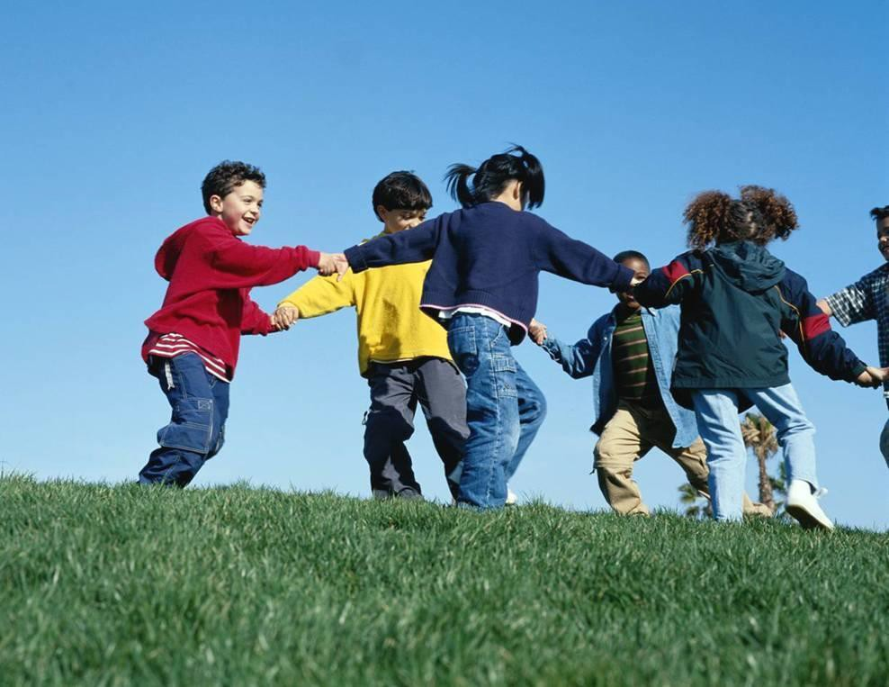
Social Health
Social Health deals with the way react with people within our environment.
This includes: public health, family relationships, and peer relationships.

Slide 51
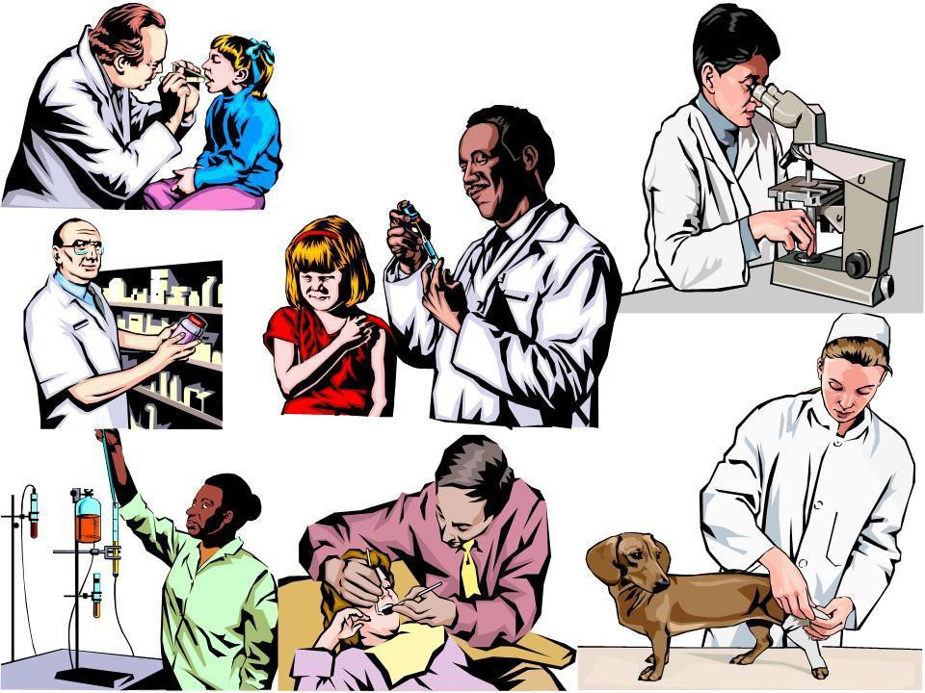
Social Health Public Health
Public health includes disease prevention and promoting health through good decision making.
Keeping yourself safe and healthy benefits your community as a whole.

Slide 52
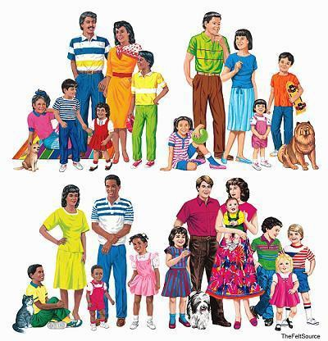
Social Health Family Relationships
A healthy family relationship is one that is supportive, loving, responsible, and balanced.
Families should work together to eliminate stress and negativity in the home. Promoting a safe and enjoyable environment.

Slide 53
Social Health Peer Relationships
Strong and supportive friendships increase happiness, self-esteem, and reduces stress.
Friends are there to help celebrate your accomplishments and there to offer support in times of need.

Slide 54
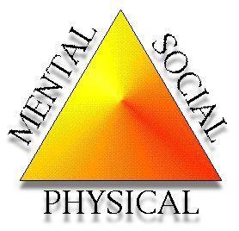
The Health Triangle Review
There are 3 major areas of the health triangle: physical, mental and social.
Good decision making and healthy choices reduce the risk of disease and increase health overall.

Slide 55
Write a Summary
What can you do to improve your Health and balance
your triangle?

