Slide 1
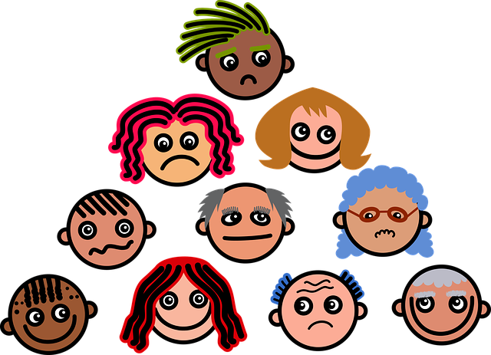
ALL
EMOTIONS
MATTER

Slide 2
The goal of this lesson is to:
• Validate feelings and emotions.
•Teach students to manage their response to emotions rather than change how they feel.
• Understand that we are not our emotions

Slide 3
EMOTIONAL LITERACY

Slide 4
EMOTIONS ARE:
Feelings!

Slide 5
POSITIVE & NEGATIVE
EXERCISE

Slide 6
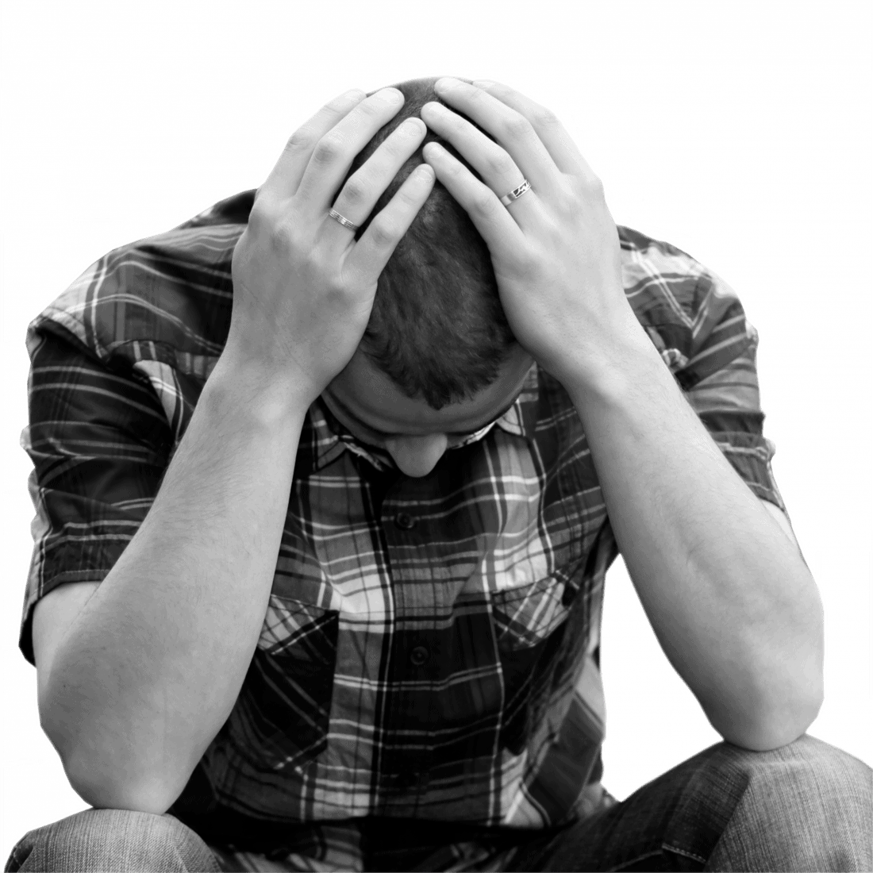
WHAT DOES ANGER FEEL LIKE?

Slide 7
What does your body physical
feel like when you feel happy?

Slide 8
WHAT HAVE WE LEARNED?

Slide 9
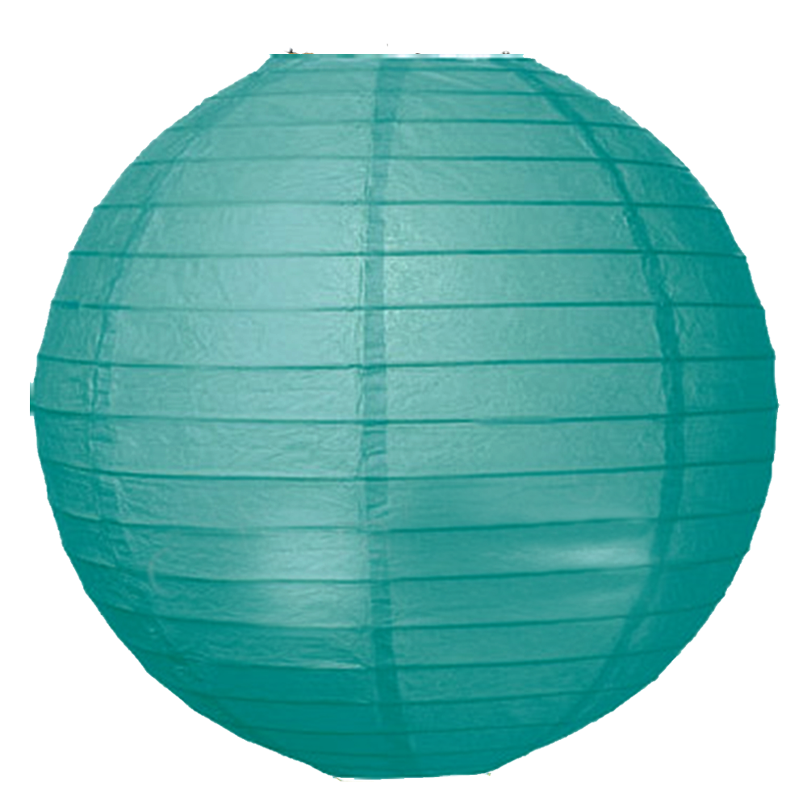
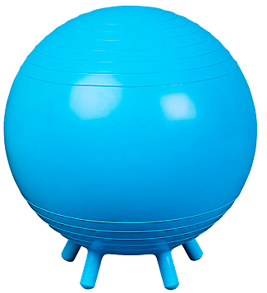
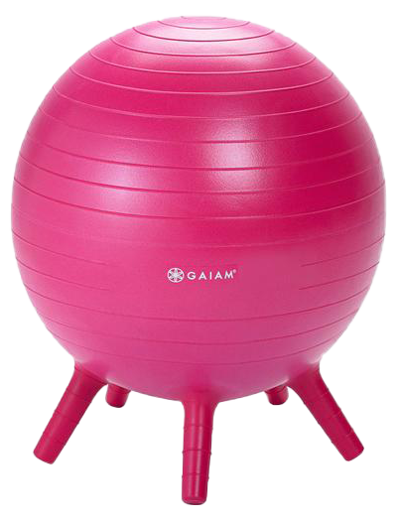
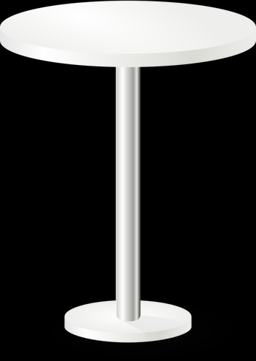
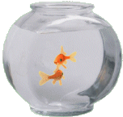
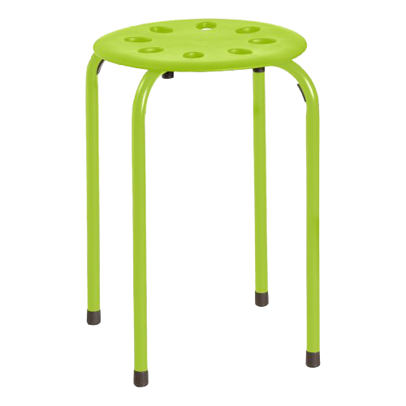
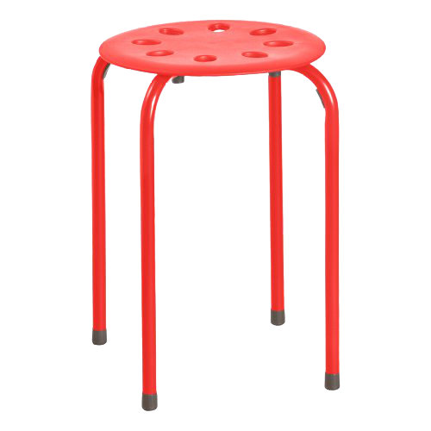
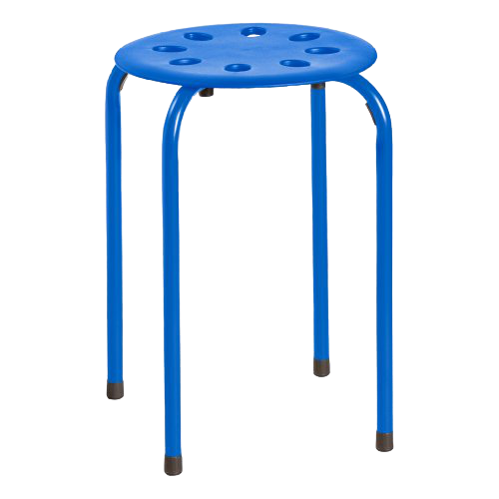
BODY SCAN
RELAXATION
MEDITATION
DEEP BREATHING

