Slide 1
SMART Goals
EQ: How does setting goals enhance my health?
I Can: I can evaluate and set goals related to personal health practices.

Slide 3
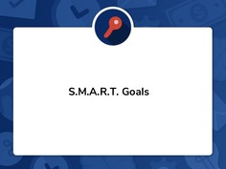

Slide 8
