Slide 1
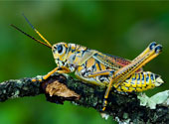

Insect Olympics
NATIONAL GEOGRAPHIC EXPLORER
On your mark. Get set. Go!
The Insect Olympics are about to begin.

Slide 2
Higher, Faster, Stronger!
That's the motto of this summer's Olympic Games. It's also a goal for the more than 1 million insect species known to be living today. If an insect meets its goal, it survives. To do this, an insect needs to beat its competition.

Slide 3
Insects are incredible, but can they beat other members of the animal kingdom? To find out, we've put together the Insect Olympics. We've matched insects with some other amazing animals. We'll test each for speed, strength, or even their ability to spit. Let the games begin!

Slide 4
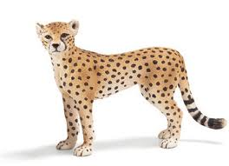
Fastest
Everyone knows cheetahs are fast. These cats can go from zero to 112 kilometers (70 miles) per hour in seconds. You might think that nothing can outrun these fast felines. You should think again.

Slide 5
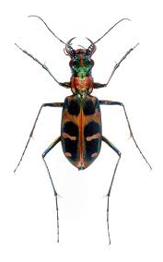
Imagine that we shrank a cheetah down to the size of a tiger beetle. Both animals are now at the starting line. They're off!

Slide 6
The tiger beetle moves 170 times its body length in just a single second. The cheetah covers about 20 body lengths per second. The tiger beetle races past the finish line long before the cheetah.

Slide 7
In the wild, the tiger beetle moves so fast, its large eyes can't keep up with it. When chasing its dinner, it briefly loses its sight. It has to stop to see. Now that's blinding speed.
Stop and Summarize

Slide 8
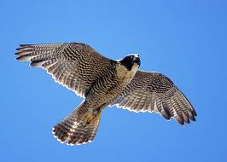
Zippiest
Our next two competitors are ready. The peregrine falcon is stretching its wings. This falcon is known throughout the skies for its speed. While diving through the air, it can reach over 390 kilometers (242 miles) per hour. Since this falcon is one of the fastest fliers, this may not be much of a contest.

Slide 9
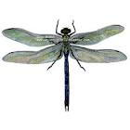
Here comes the underdog. It's the green darner. This dragonfly is one of the fastest flying insects. There's even one kind of darner that can jet around at almost 90 kilometers (55 miles) per hour.

Slide 10
There they go! Bird and insect are off to a fast start. Wait. What's that? The dragonfly has stopped. It's hovering. Now it's diving. Oh, this is too much. Now it's flying backward!
Stop and Predict

Slide 11
Those are awesome antics, but the dragonfly can't out-fly the falcon. The bird's normal speed is close to the dragonfly's best effort. In a race between dragonflies and falcons, the checkered flag goes to the birds.

Slide 12
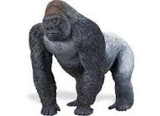
Strongest
Now we're ready to see what is the strongest competitor. Here comes the silverback gorilla. This primate is a large and powerful animal.

Slide 13
The gorilla moves through the jungle and stops to flex its muscles. Its arm muscles are larger than its leg muscles. It uses them to break heavy branches.

Slide 14
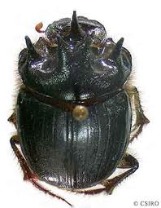
The horned dung beetle is going to test its strength against the gorilla's. Wow. It looks like the gorilla has to win this contest. Some scientists say the gorilla can lift 10 times its weight.

Slide 15
Not so fast. Scientists studying the beetle found that it can lift a whopping 1,141 times its weight. These beetles often used their super strength to fight other beetles and defend their territory.

Slide 16
Good thing for the gorilla that it isn't the same size as the beetle. There would be a rumble in the jungle. In this matchup, the beetle wins.

Slide 17
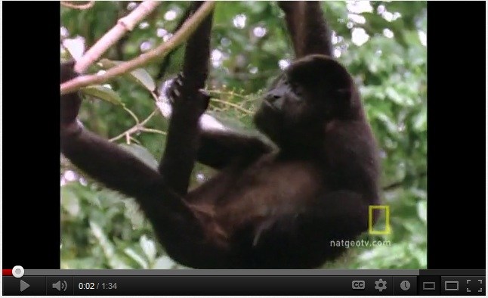
Loudest
Up next is an ear-splitting competition. We're looking for the world's loudest animal. Let's start with the howler monkey. Its cries can be heard for 5 kilometers (3 miles) through thick rain forest.
Click to see and hear the howler monkey in action.

Slide 18
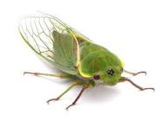
When it comes to howling, the howler monkey lives up to its name. It may not be louder than the cicada, though. A male cicada has a thick membrane across its abdomen. It makes a clicking sound by moving this membrane. A chamber inside its body makes the clicking sound louder. In fact, the sound is so loud, it could cause hearing loss in people.
Click to hear the sound of the cicada.

Slide 19
When a howler monkey goes up against a cicada, it's a tie. The monkey's sound carries 12 times farther than the cicada's. Yet its sound isn't as intense. So the cicada wins on volume, but the howler monkey wins on distance.

Slide 20
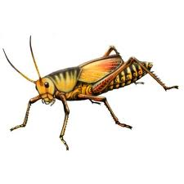
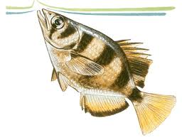
Wettest?
You might want to put on a raincoat for our last matchup. A lubber grasshopper and an archerfish are both champion spitters. We're going to see which one can spit the farthest.

Slide 21
The grasshopper spits a brown liquid to keep predators away. The archerfish shoots a spray of water to knock flying insects out of the air. It then gobbles up the fallen bugs.

Slide 22
The hungry fish goes after lots of insects, including grasshoppers. So this is one contest the grasshopper doesn't want to lose. After all, if the fish misses, it aims again and again. It might spit rat-a-tat-tat six or seven times.

Slide 23
Watch out! Predator and prey are spitting at each other. This matchup is going nowhere!

Slide 24
Despite all the splatter from the spitting contest, the Insect Olympics were a success. Insects didn't win every event. Yet they showed they are strong contenders in the animal kingdom. They may be small, but they are among the strongest, fastest, and loudest critters on Earth.

Slide 25
Click on any the name of any insect you’d like to know more about.
cicada
green darner dragonfly
horned dung beetle
lubber grasshopper
tiger beetle

Slide 26
Article by Marylou Tousignant. Photograph by Tyler Fox/ Shutterstock.com.
© 2012 National Geographic Learning. All rights reserved.
Retrieved from
http://magma.nationalgeographic.com/ngexplorer/1205/articles/mainarticle.html
You have finished reading this article. Click here to return to the beginning and to reread it.

Slide 27
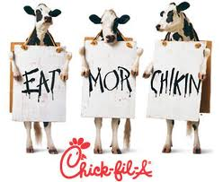
motto
noun—a sentence, phrase, or word expressing the spirit or purpose of a person, group, etc.
The motto of Wheaties cereal is “breakfast of champions.”
The motto of the US Army is “Be all that you can be.”
The motto of Chick-fi-A is “Eat Mor Chikin!”

Slide 28
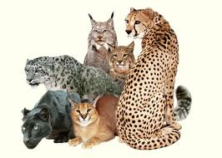
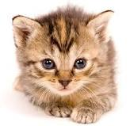
species
noun—a group of plants, animals, or insects that are related to one another and that have common characteristics
For example, all cats are members of the feline species.

Slide 29
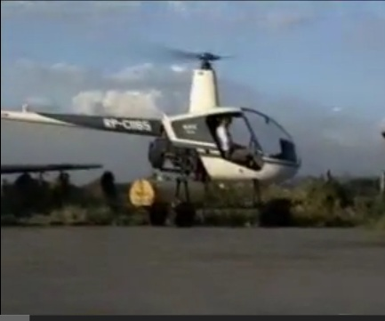
hovering
verb—to hang in the air in one place without moving forward, backward, or up or down
Helicopters and hummingbirds hover in the air.
Click the picture of the helicopter to watch it hover.

Slide 30
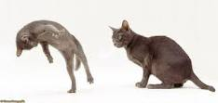
antics
noun—playful tricks
Cartoon characters, funny clowns, and even animals are known for their antics.

Slide 31
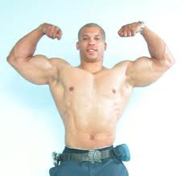
flex
verb—to bend; often to bend a part of the body
Bodybuilders flex the muscles of their arms when they lift weights.

Slide 32
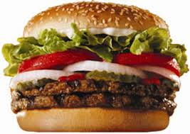
whopping
adjective—very large
Burger King calls one of its sandwiches the Whopper so that customers will know it’s a really big burger.

Slide 33
territory
noun—a specific area of land
The root word terra means earth or land, so whenever you see a word like territory that includes the root terra, remember that it relates to earth or land.
Often, individuals, governments, countries, or even animals have specific territories that belong to them or that they use.

Slide 34
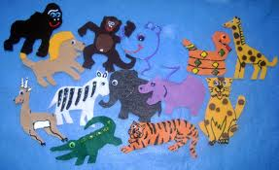
rumble
noun—slang for a street fight
In this text, rumble is used to paint a word picture of animals fighting.

Slide 35
competition
noun—a contest between two or more individuals or groups that ends up with winners and losers
In school, students often have spelling or writing competitions.
Olympic athletes have competitions to see who can run the fastest.

Slide 36
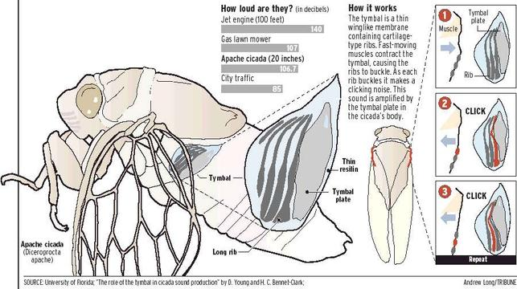
membrane
noun—a thin layer of animal tissue

Slide 37
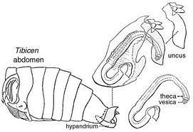
abdomen
noun—the part of a body where the stomach and intestines are located
The abdomen is usually located on the underside of insects.

Slide 38
intense
adjective—strong, extreme, very great
When it’s over 100 ͦ, the heat is intense.
People who are very angry often show intense emotions.

Slide 39

predator
noun—an animal that hunts, kills, and/or eats another specific kind of animal
Follow this link to learn about the top 10 animal predators:
http://animal.discovery.com/tv/a-list/creature-countdowns/predators/predators.html
In this picture, the large cat is a predator.

Slide 40
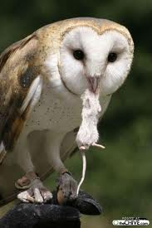
prey
noun—an animal that is hunted for food by another animal
In this picture, the mouse is the prey of the owl.

Slide 41
contenders
noun—people or animals who compete against one another for a prize or to decide who is better or stronger
In football, the top teams are contenders for the Super Bowl title.
In the United States, we usually have two contenders for President, one Democrat and one Republican.

Slide 42
Stop and Summarize
List one way the cheetah and the tiger beetle are alike.
List one way the cheetah and the tiger beetle are different.
Write one sentence to summarize these similarities and differences.

Slide 43
Stop and Predict
Do you think the peregrine falcon OR the green darner dragonfly will win the race.
Find at least two facts from the text that support your prediction.

