Slide 1
The Writing Process:
Turning your Research into
Informational Writing

Slide 2
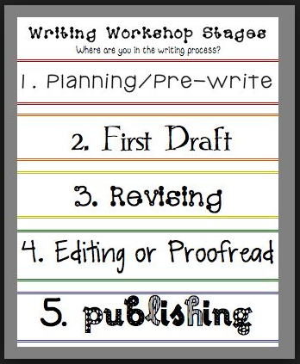

Slide 3
Research: Before the Writing Process
You have already completed the research for your country.
Let’s practice how to translate your research into a graphic organizer.
THINK: What is your favorite food?

Slide 4
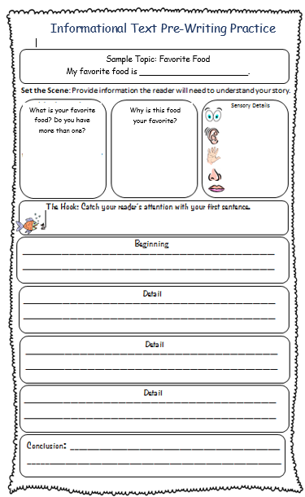

Slide 5
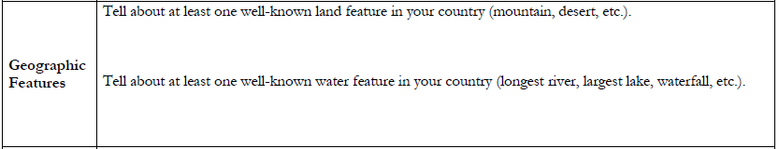
Country Research: United States

Slide 6
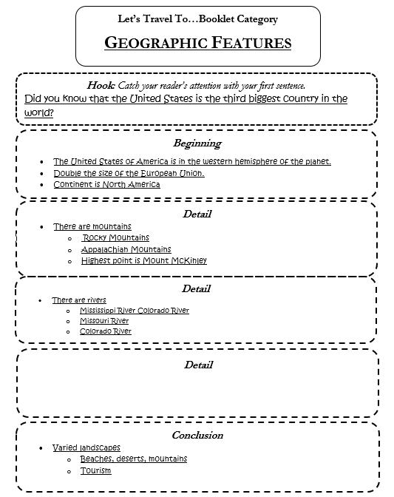

Slide 7
Revise
How do I turn my graphic organizer text into sentences?
Each detail should be at least one sentence
Each sentence should be complete
For example:
Topic sentence first set of details: The United States has a variety of mountain ranges.
Additional detail: One of the most popular mountain ranges in the US are the Rocky Mountains.
What additional detail about the Rocky Mountains can we include?

Slide 8
Revise
My Favorite Food is
______________.

Slide 9

Revise
WritE It!

Slide 10
Revise

Slide 11
Proofread

Slide 12
Publish

