Slide 1



Use the Pirate
P.A.T.C.H.
to Construct an Awesome Response!

Slide 2
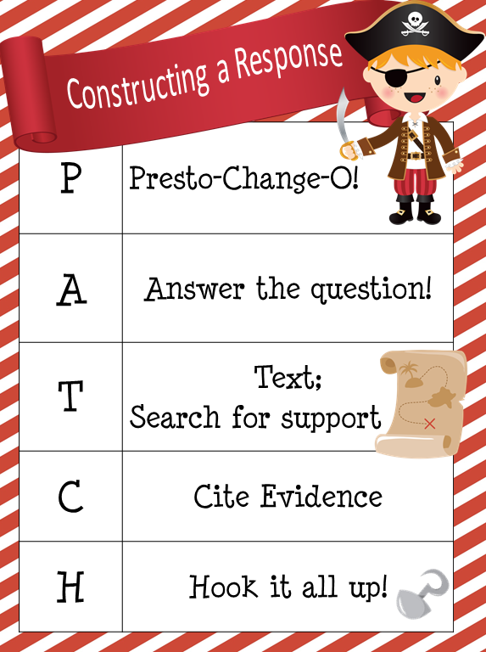

Slide 3
P = Presto Change-O!
Use the words from the question to form a topic sentence.

Slide 4
A = Answer the question!
Be sure that you understand what you are being asked and answer ONLY the question given. Do not begin retelling the story or go off-topic.

Slide 5
T = Text Support
Find evidence from the text that will support your opinion or position. Finding support for your ideas demonstrates your clear understanding of a topic.

Slide 6
C = Cite Evidence!
Let us know where you found your evidence and support.
In the first paragraph . . .
In the closing sentences, . .
The author clearly states. .
Give credit and use punctuation when needed.

Slide 7
H = Hook it up!
Provide closure for your reader with a good conclusion. Restate or revisit your topic and connect all your supporting details to that topic. Match them up, and explain your position thoroughly.

