Slide 1
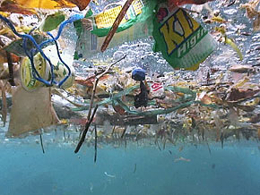
Ocean Pollution

Slide 2
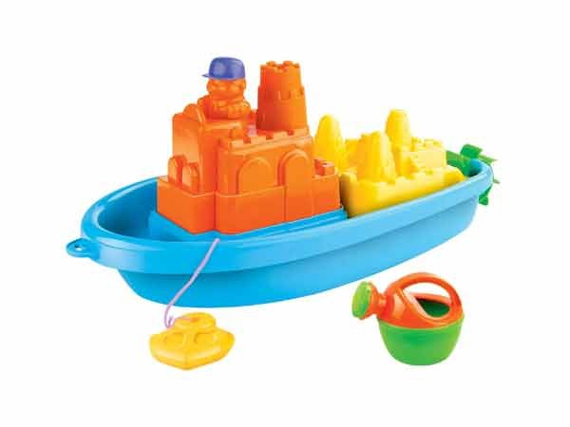
Boat and Animals

Slide 3
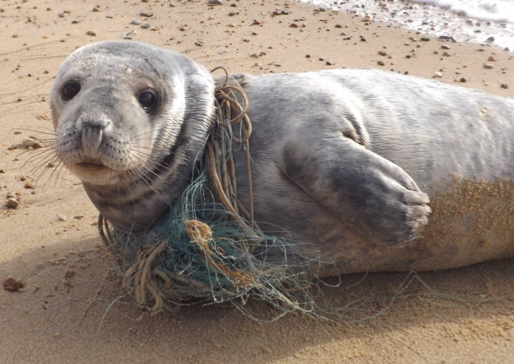
#1 Fishing Line

Slide 4
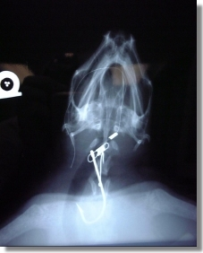
#2 Fish Hooks

Slide 5
#3 Newspaper

Slide 6
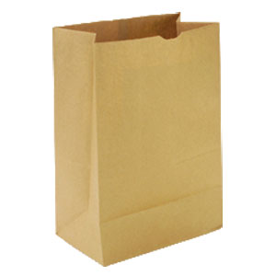
#4 Paper Bags

Slide 7
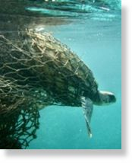
#5 Fishing Net

Slide 8
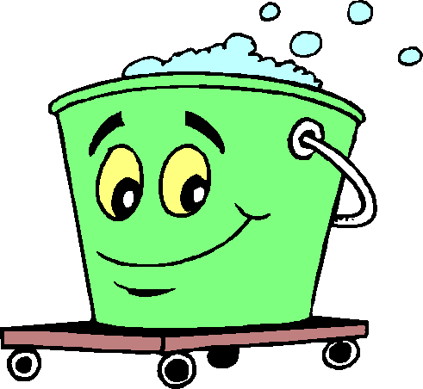
#6 Soapy Water

Slide 9
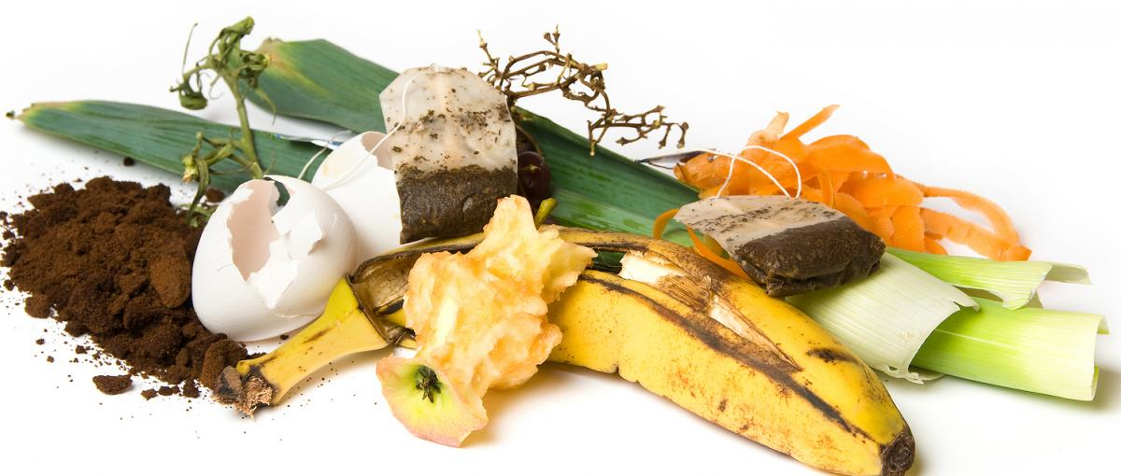
#7 Food Scraps

Slide 10
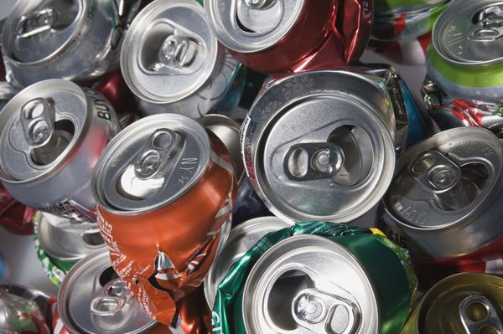
#8 Aluminum Cans

Slide 11
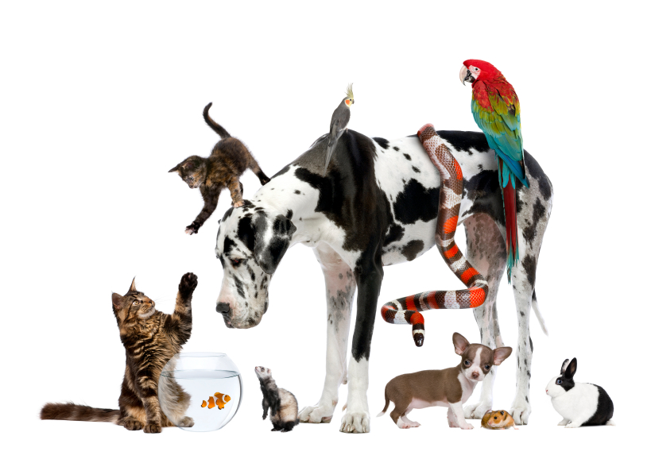
#9 Pet Waste

Slide 12
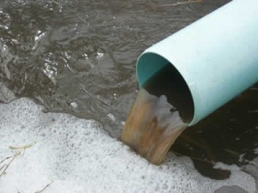
#10 Factory Waste

Slide 13
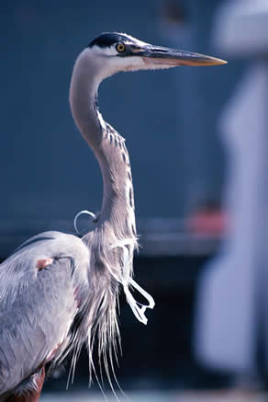
#11 Six Pack Rings

Slide 14
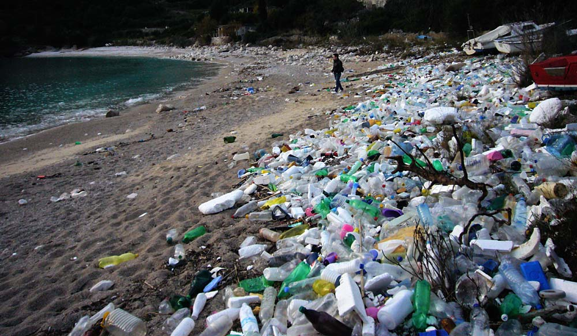
#12 Plastic Bottle

Slide 15
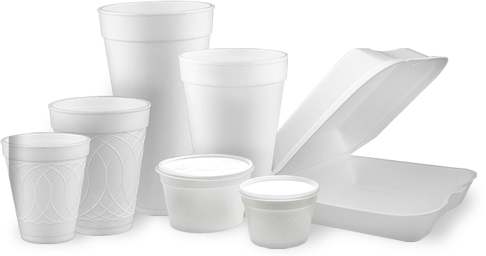
#13 Styrofoam

Slide 16
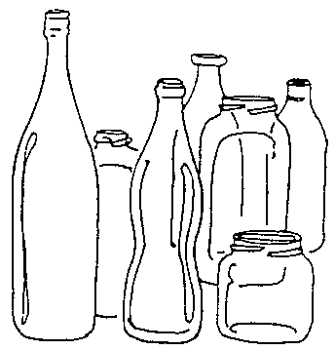
#14 Glass

Slide 17
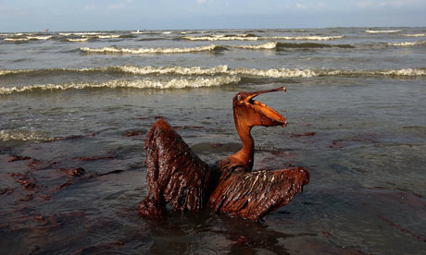
#15 Oil

Slide 18
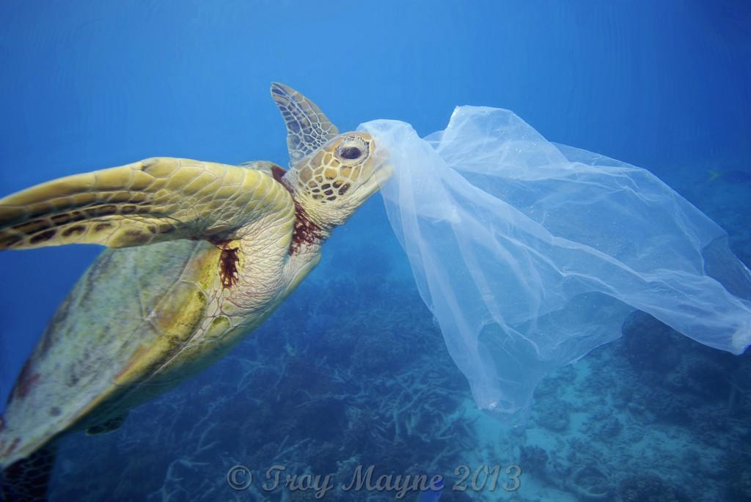
#13 Plastic Bag

Slide 19
How can we help stop ocean pollution?

