Slide 1
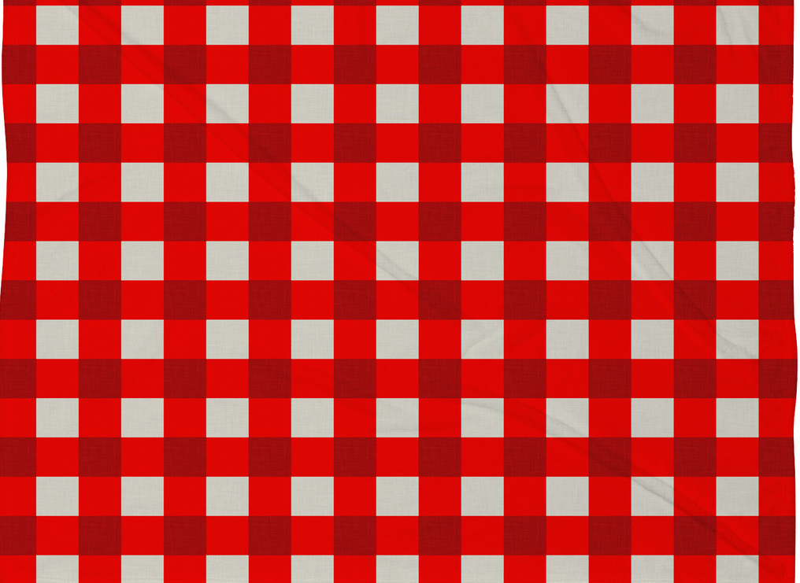
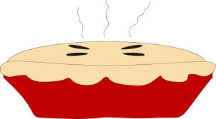
First Impressions:
Should you ever judge a book by its cover?
based on the book
Enemy Pie
by Derek Munson
Unit by Michelle Davis,
Kingsland Elementary School
Notes:
First Impressions: Should you ever judge a book by its cover?
For more information please visit www.peachteach3.com

Slide 2
Unit EQ: Should you always judge a book by its cover?
How important are first impressions?
Lesson 1:
Lesson 2:
Lesson 3:
Lesson EQ:
How do writers make a good first impression?
Lesson EQ:
How do people form impressions about the world around them?
Lesson EQ:
What factors can cause a person’s first impression to change?
How do authors “hook” us or capture our interest?
How do authors build suspense?
What are some good ways to begin a story?
What makes a book a page-turner?
What are our five senses?
Which sense is the most important?
How does sensory language help us visualize and connect?
How can I use sensory language in my writing?
In a story, how can understanding perspective help us understand a character’s feelings?
What kinds of things affect a character’s point of view?
What does it mean for a character to grow?
Notes:
This overview of the unit may be helpful in the beginning and throughout the teaching to keep the focus on specific learning targets.

Slide 3
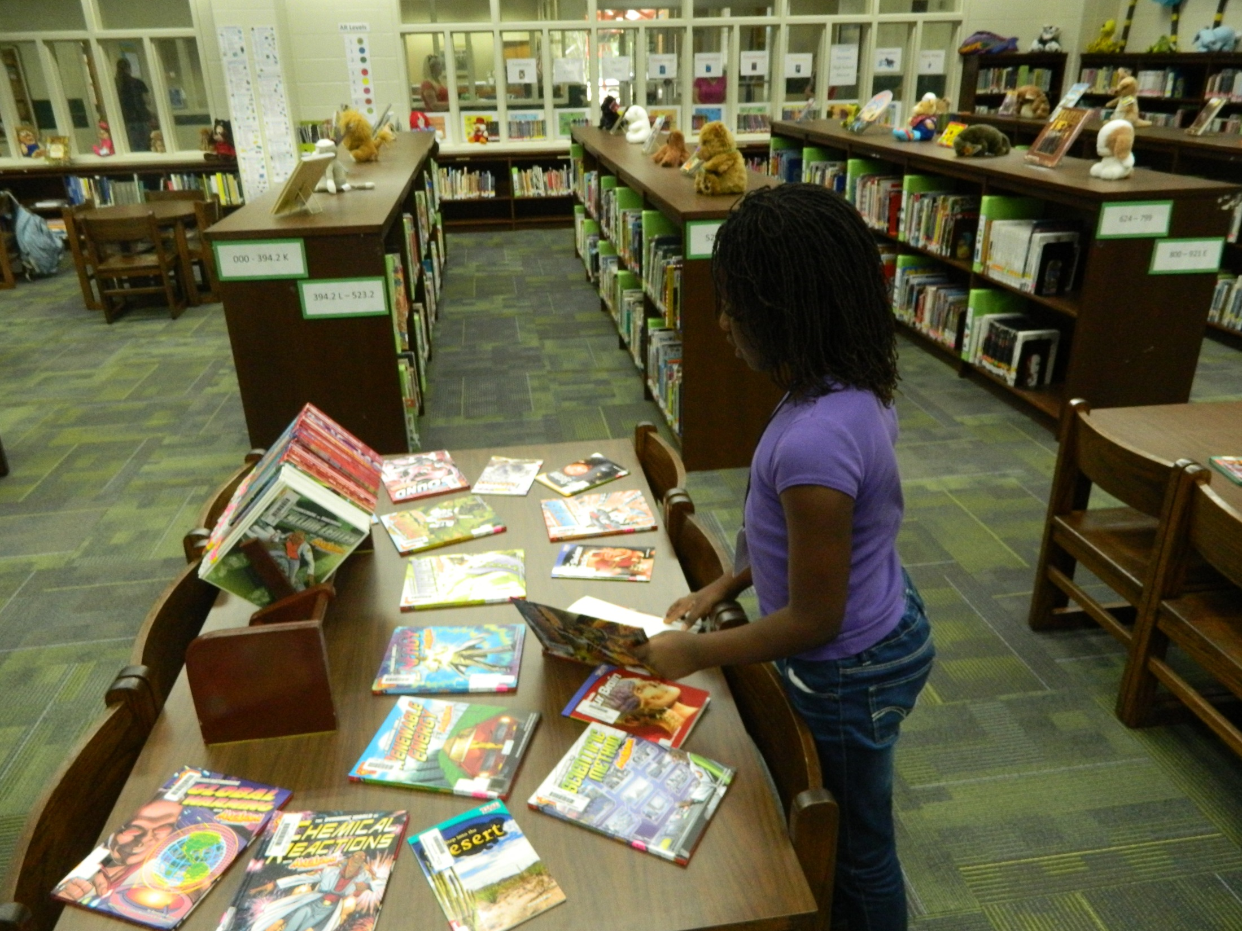
How do you choose a book?
Notes:
Activating Strategy. Ask students to think about the question, “When you go to the library or shop online, how do you choose a book?”

Slide 4
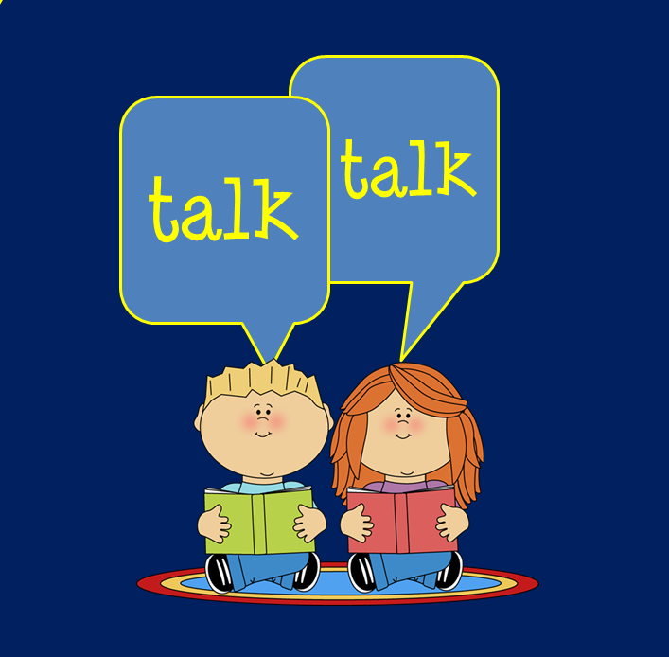
What might attract you to a particular book?
Are illustrations important?
Does it matter if you recognize the author?
What topics do you find most interesting?
Do you like to read books in a series?
Notes:
Read these prompts aloud as a class. Students should turn and talk, discussing their ideas with a partner. Volunteers may share ideas. There are several “turn and talk” opportunities in this unit and they are marked with the same icon.

Slide 5
Lesson 1:
EQ: How do writers make a good first impression?
How do authors capture our interest?
How do authors build suspense?
What are some good ways to begin a story?
What makes a book a page-turner?
Notes:
Essential Question and additional prompts for Lesson 1.

Slide 6
Standards
I can ask and answer questions about what I read.
I can explain how the illustrations or pictures relate to the words I am reading.
I can say my opinion and explain why I feel that way.
I can write an opinion as a statement, and I can add reasons to support my point of view.
I can introduce my topic.
I can write short pieces and long pieces, and I understand that different tasks need different kinds of writing.
I can participate in a discussion. I can use good manners, and I can respect my partner, teacher, and classmates. I can say things about the topic and show my understanding.
I can speak in complete sentences.
ELACC3RL1: Ask and answer questions to demonstrate understanding of a text, referring explicitly to the text as the basis for the answers.
ELACC3RL7: Explain how specific aspects of a text’s illustrations contribute to what is conveyed by the words in a story (e.g., create mood, emphasize aspects of a character or setting).
ELACC3W1: Write opinion pieces on topics or texts, supporting a point of view with reasons.
a. Introduce the topic or book they are writing about, state an opinion, and create an organizational structure that lists reasons.
b. Provide reasons that support the opinion.
ELACC3W10: Write routinely over extended time frames (time for research, reflection, and revision) and shorter time frames (a single sitting or a day or two) for a range of discipline-specific tasks, purposes, and audiences
ELACC3SL1: Engage effectively in a range of collaborative discussions (one-on-one, in groups, and teacher-led) with diverse partners on grade 3 topics and texts, building on others’ ideas and expressing their own clearly.
ELACC3SL6: Speak in complete sentences when appropriate to task and situation in order to provide requested detail or clarification.
Notes:
Standards covered in this lesson. Click to change the standards to “I Can” statements.

Slide 7
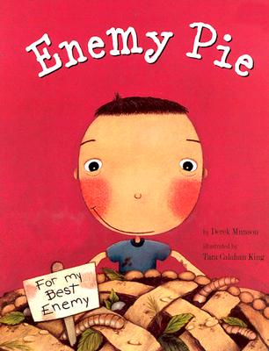
How does this book capture your interest?
Notes:
Allow students to look at the cover for a few moments and think about what they notice. Partners may discuss. Then reveal the question.

Slide 8
Look at the title!
Notes:
Remind students that when previewing anything we are about to read, the title is the first thing we should notice. Also, this is a good time to remind them that titles should always be capitalized. Something is different about this title! What is it?

Slide 9
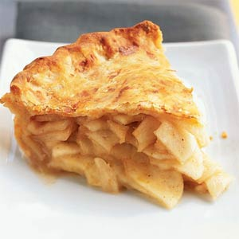

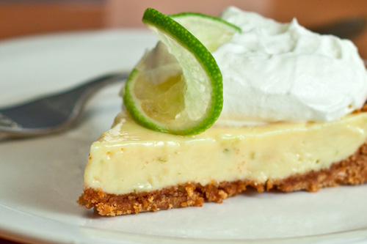
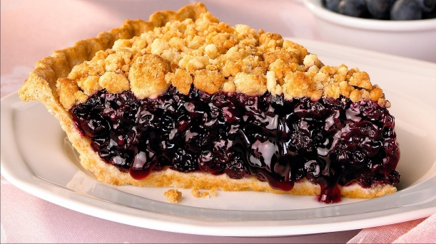
What does this word mean?
Pumpkin Pie
Apple Pie
usual
What are some usual names for pies?
Blueberry Pie
Key Lime Pie
Notes:
Ask students to look at the word usual. Discuss the meaning of the word as well as synonyms such as common, predictable, typical, ordinary, etc. What are some usual names for pie? Brainstorm suggestions and then reveal the preselected examples on this slide. What is true about all of these? (They are fruits, vegetables, foods, etc. )

Slide 10

unusual
prefix
Complete this statement:
Enemy Pie is an unusual title because __________________.
Notes:
Remind students that a prefix is a word part that comes at the beginning. By adding the prefix un- to usual, we have created a new word with a different meeting. Usual and unusual are antonyms. Have them think about the unusual title of this book. Remind students to speak or write in complete sentences. Students may complete this verbally, on paper, or via technology. A Google Form would collect responses efficiently for sharing. Also, this activity would be perfect for www.todaysmeet.com

Slide 11
Does the cover art grab your attention?
Notes:
Standard: ELACC3RL7: Explain how specific aspects of a text’s illustrations contribute to what is conveyed by the words in a story (e.g., create mood, emphasize aspects of a character or setting). Students should take a look at the cover art and discuss with partners or as a class. Does this picture capture our attention, build suspense, and make us want to read more?

Slide 12
Notes:
Standard: ELA.3.RL.7: Explain how specific aspects of a text’s illustrations contribute to what is conveyed by the words in a story (e.g., create mood, emphasize aspects of a character or setting). Observations?

Slide 13

Complete this statement:
When I first saw the cover art of Enemy Pie, I thought, “_______
_________________________.”
Notes:
Remind students that a prefix is a word part that comes at the beginning. By adding the prefix un- to usual, we have created a new word with a different meeting. Usual and unusual are antonyms. Have them think about the unusual title of this book. Remind students to speak or write in complete sentences. Students may complete this verbally, on paper, or via technology. A Google Form would collect responses efficiently for sharing. Also, this activity would be perfect for www.todaysmeet.com

Slide 14
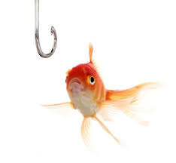
How do authors hook their readers?
How do they grab our attention and keep us reading?
The beginnings of stories are important!
Notes:
Ask students to look a the picture for a moment. Then reveal the questions. Think about the first sentence of a story and how it can hook you and draw you in to the book.

Slide 15


It should have been a perfect summer.
Should?
Adds mystery!
Notes:
Have students look at this sentence. Good readers ask questions! What questions do you have after reading this sentence? One way that authors “hook” readers is by beginning with a mystery. Now, we want to know: Should? Why isn’t it a perfect summer now? What happened? What ruined the perfect summer?

Slide 16

Complete this statement:
The first sentence of Enemy Pie creates a mystery because __________________.
Notes:
There are multiple opportunities for students to practice speaking in complete sentences. Students cannot write complete sentences unless they learn to think/speak complete sentences.

Slide 17


Summarize
How did the book Enemy Pie capture our interest right away?
a unique,
unusual
title
interesting
(disgusting)
cover art
mysterious
first
sentence
Did the author make a good first impression?
Notes:
Ask students to think about the question and remember our lesson/discussions. Reveal answers. Then, ask the question, “Did the author make a good first impression?” Have students discuss as partners and then as a class.

