Slide 1
Kiosks at Ellis Island
A Coding Project

Slide 2
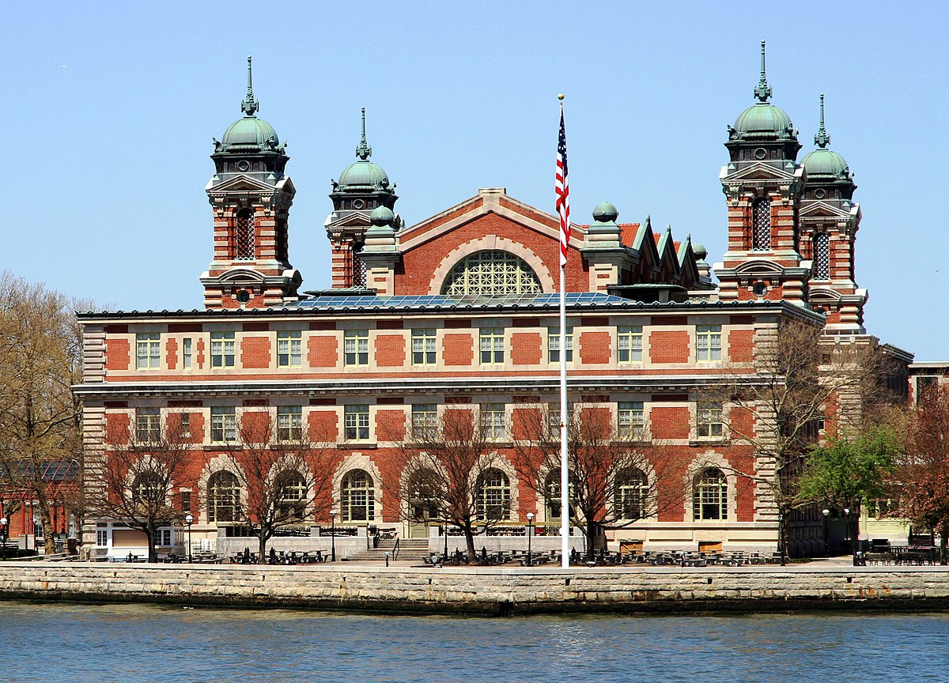
Ellis Island Needs Your Help!
Background Information:
The curator at Ellis Island wants to add Kiosks to their museum. She wants to teach visitors about WHO immigrated to the United States and WHY they came to America.

Slide 3
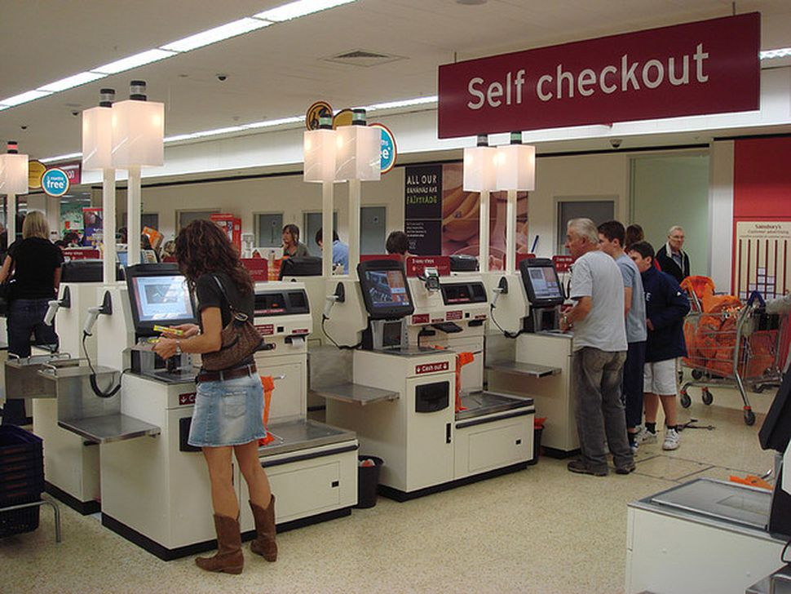
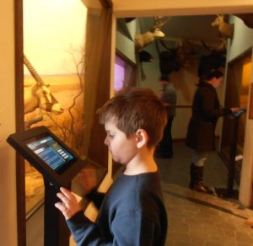
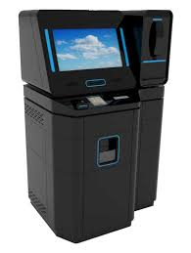
What are Kiosks?
A small stand-alone device providing information and services on a computer screen

Slide 4
Your Task as the Coder
Choose a group of immigrants that came to America between 1892-1954.
  Refer to your notes from your social studies class
Write your narrator’s speech once you have answered these three questions
  What country did the group come from?
  Why did the group leave the country?
  Describe an experience (good or bad) that the immigrants may have had while at Ellis Island.

Slide 5
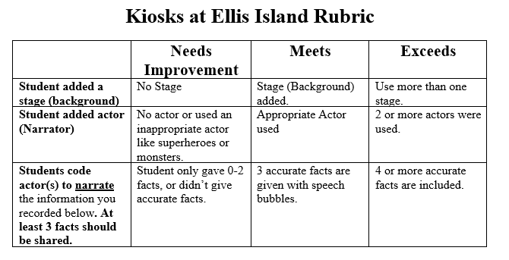
Now Create The Program for Your Kiosk

