Slide 1
Cell Transport Unit

Slide 2
Do Now:
Copy this box in your lab book.
For each of the four quadrants, you will write a sentence using the sentence frame on the next slide.
Cells
Notes:
Option 1: Cell synectics to engage students in thinking about cells
Solicit word suggestions from students, or use a random noun generator: https://www.textfixer.com/tools/random-nouns.php
https://www.randomlists.com/nouns

Slide 3
For each of the four words, write a sentence in one of the four side quadrants using this sentence frame:
Cells are like a(n) __ because…
3→ minutes think & write
2→ minutes table talk
1→ best simile shared
Building
Cells
Fish
Border
Scarecrow

Slide 4
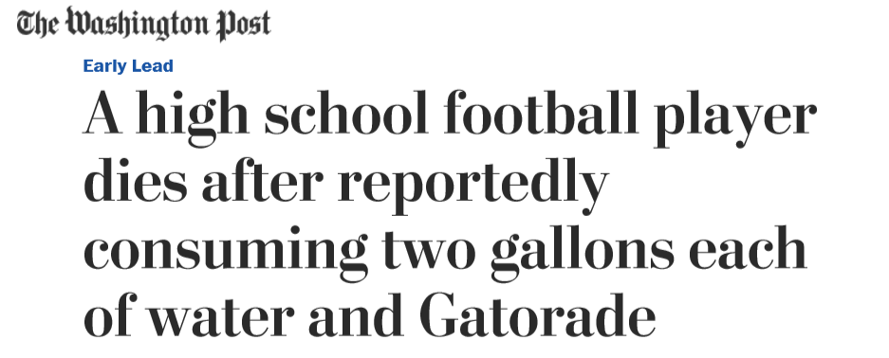
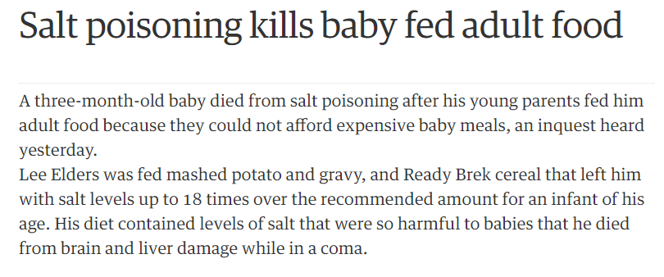
Engagement Task: Case Studies
Read the three case studies.
Think about cells and homeostasis as you read.
Answer the questions at the end.
Notes:
https://goo.gl/ZYzBbX

Slide 5
Case Study Questions:
In what ways were the causes of death in the case studies the same? In what ways were they different?
If water is taken in through the digestive system, how did two of the patients die from swelling around the brain?
How do you think the symptoms described in the case studies might be related to events happening in and around the cells?

Slide 6
The facts about Case Study One:
Football practice on a hot summer day
Drank two gallons of water and two gallons of Gatorade
Complained of cramping, headaches
Unable to drive home, later collapsed, went into coma
Cause of death was massive swelling around the brain from overhydration

Slide 7
The facts about Case Study Two:
Sitting in a room with 18 other contestants
Drank nearly two gallons of water without urinating
Complained of headache, swollen abdomen, vomiting
Several contestants vomited, complained of pain
Became disoriented on the drive home, later collapsed
Cause of death was massive swelling around the brain from overhydration

Slide 8
The facts about Case Study Three:
Three-month old baby’s parents fed him adult foods
Baby foods are made with very little salt content
Very small amounts of salt can be fatal to babies
The child had seizures, went into a coma
Cause of death was hypernatremia, when the electrolyte (salt) to water ratio becomes too high
Hypernatremia death may also be caused by dehydration when a child has vomiting/diarrhea

Slide 9
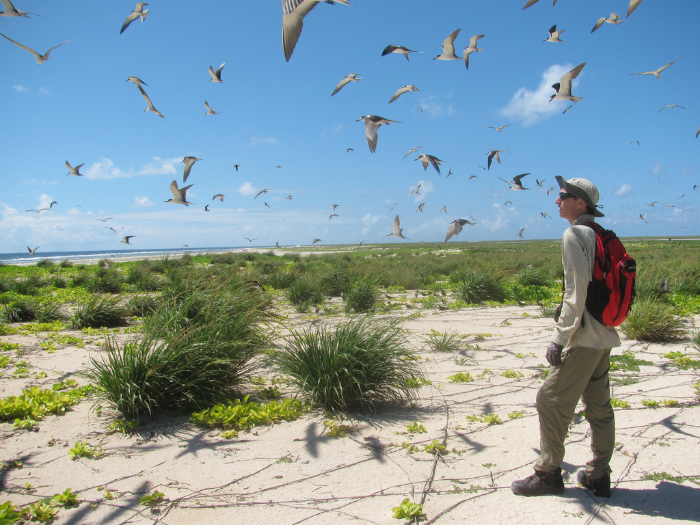
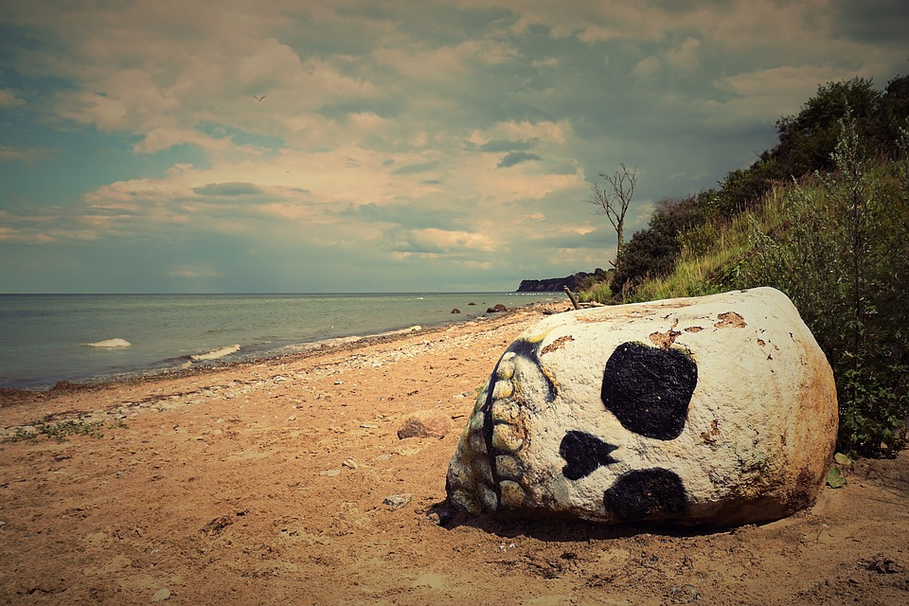
The Shipwrecked Sailor
A shipwrecked sailor is stranded on a small desert island with no fresh water to drink. He knows he could last without food for up to a month, but if he didn't have water to drink he would be dead within a week. Hoping to postpone the inevitable, his thirst drove him to drink the salty seawater. He was dead in two days.

Slide 10
What happened?
Why do you think drinking seawater killed the sailor faster than not drinking any water at all?
?

Slide 11
Objective:
To determine the cause of the sailor's death, we will determine the effects of salt water on slices of potato (which represent a body). Specifically, we will measure changes in the mass of the potato slice.
Our assumption is that potato cells will behave like the sailor’s cells in his body.
Research Question: How does salt water concentration change the mass of potato slices?

Slide 12
Pre-lab Questions:
Answer these questions based on your current understanding of the topic.
What roles did water and salt play in the deaths of the people in the case studies?
Is is possible for water and/or salt to enter and/or exit the cell? Support your answer.
What is the role of the cell membrane in homeostasis in the cell?

Slide 13
Hypothesis
If the salt concentration increases, then_____________.
Describe what you think will happen to the potato cells.
Explain why you think it will happen.
Materials:
Graduated cylinders
20% Salt solution
Cups
Sharpies
Potato sections

Slide 14
Pre-lab: Make Saltwater Solutions
Percent sSltwater
Vol. of 20% Saltwater (mL)
Vol. of distilled water (mL)
Total Vol. (mL)
Distilled water
0.0
40.0
40.0
0.5% saltwater
40.0
1% saltwater
40.0
5% saltwater
40.0
10% saltwater
40.0
20% saltwater
40.0
0.0
40.0
Notes:
Given 20% sea water (salt solution) and distilled water, use ratios to calculate what amount of each is needed to make each percent of sea water.
Answers on the next slide

Slide 15
Pre-lab: Make Saltwater Solutions
Percent Saltwater
Vol. of 20% Saltwater (mL)
Vol. of distilled water (mL)
Total Vol. (mL)
Distilled water
0.0
40.0
40.0
0.5% saltwater
1.0
39.0
40.0
1% saltwater
2.0
38.0
40.0
5% saltwater
10.0
30.0
40.0
10% saltwater
20.0
20.0
40.0
20% saltwater
40.0
0.0
40.0

Slide 16
Record Data
Sample
Initial mass
Final mass
Change in mass
Change in Length
Turgidity
(crisp/flaccid)
20% salt
10% salt
5% salt
1% salt
0.5% salt
Fresh water

Slide 17
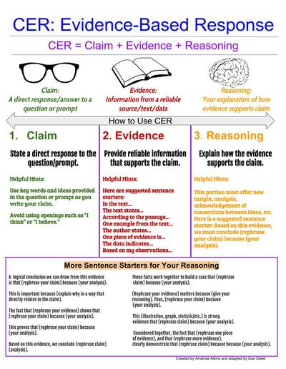
Do Now:
Answer the questions below. Support your answers with evidence from your notes and personal observations.
Is water toxic?
Is salt toxic?

Slide 18
Sample DataTable: Look for patterns in the data

Slide 19
Record Data
Sample
Initial mass
Final mass
Change in mass
Change in Length
Turgidity
(crisp/flaccid)
20% salt
10% salt
5% salt
1% salt
0.5% salt
Fresh water

Slide 20
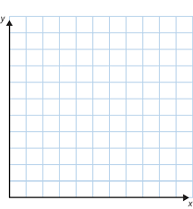
Display Data in Graphs
REMEMBER…
D = dependent variable
R = responding variable
Y = graph info on the y-axis
M = manipulated variable
I = independent variable
X = graph info on the x-axis
Mass / length
Amount of salt in the water

Slide 21
Conclusions
Address the following in your conclusion:
What happened to the potato slices over 24 hours?
What is responsible for the changes?
Which of the solutions caused the potato cells to shrink? How do you know this?
Which solutions caused the potato cells to swell? How do you know?
How is what happened in the potato cells related to what happened in the cells of the people in the case studies?
Sea water is 35% salt. Why did the sailor die more quickly drinking sea water than fresh water? What do you think killed him?

Slide 22
Do Now
You and your friends are stranded on a small island. There appears to be a stream, plants, and coconut trees. Fortunately, you have the following items:
Clothing
A backpack
A lighter
Glass and plastic bottles
Plastic garbage bags
Paracord
How would you use these resources plus any items found on the island to make sure you have a safe source of fresh water to drink?

Slide 23
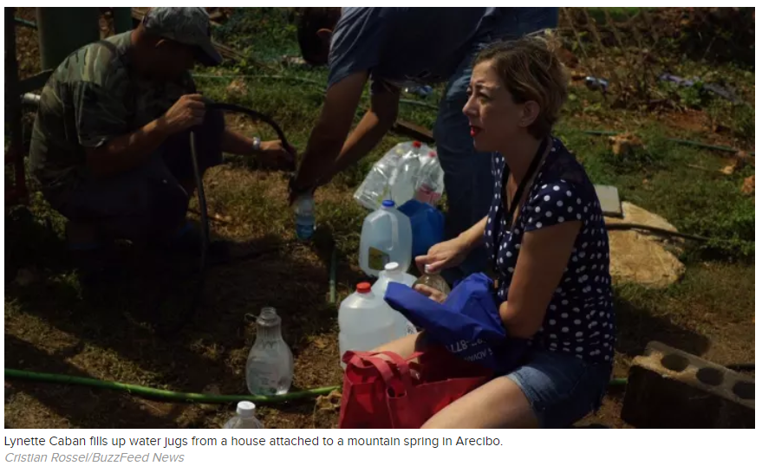
Not Enough Water?

Slide 24
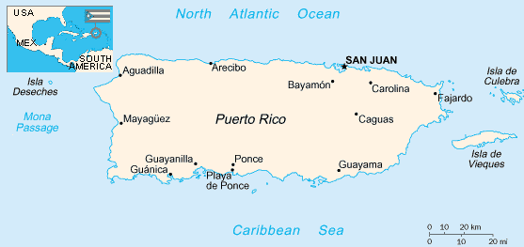
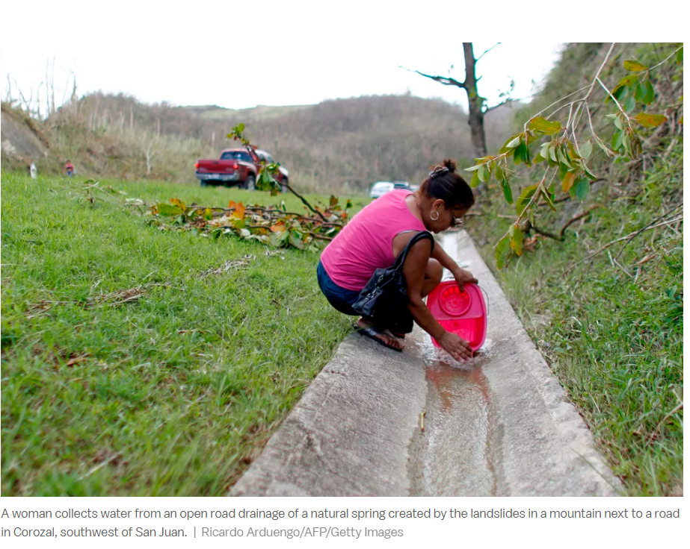
Surrounded by Ocean Water: Why can’t they drink it?

Slide 25
Water Solutions
What are some possible solutions to the drinkable water crisis in Puerto Rico?
Limiting factors to consider:
Water is around, but may not be clean or salt-free
Some areas are near the ocean, others far from the ocean
The amount of materials they have to work with is limited
Task: Create a way to capture or purify water that can be accomplished with common, inexpensive materials.

Slide 26
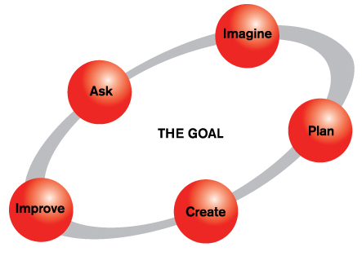
Engineering Design Process
IMAGINE: Brainstorm a water purification/desalination method that uses common, inexpensive materials
ASK: How can the people of Puerto Rico capture or purify water? Design either a water purification or desalination solution for the
people of Puerto Rico.
PLAN: Work as a team to create simple design and directions.
IMPROVE: Provide comments to each team on their design. Based on the comments of others, improve your design.
CREATE: Create a poster or slides with diagrams and words explaining your plan. Make sure it is easy to understand.

Slide 27
Water Purification System
Work as a team to create simple design illustrations and instructions.
Create a poster or slides with diagrams and words explaining your plan. Make it clear and easy to understand.
Be prepared for a brief presentation. Provide comments to each team on their design.
Based on the comments of others, improve upon or redesign your design.
See Rubric

Slide 28
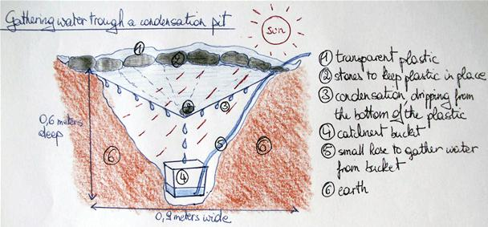
Sample Work
Notes:
https://img.wonderhowto.com/img/original/89/11/63410299583475/0/634102995834758911.jpg

Slide 29
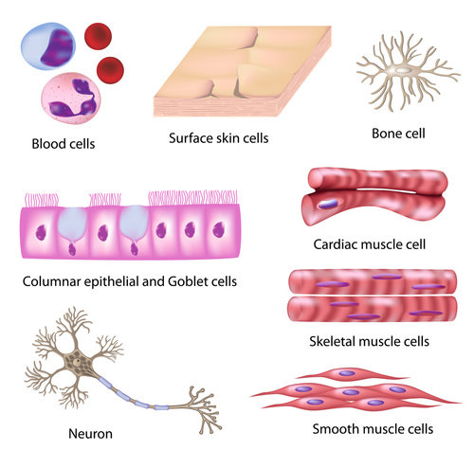
Why do these cells look the way they do?

Slide 30
Some Random Cell Facts
The average human being is composed of around 100 trillion individual cells
It would take as many as 50 cells to cover the area of a dot on the letter “i”
Notes:
30

Slide 31
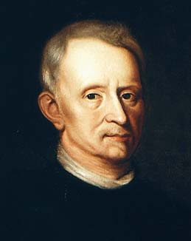
Discovery of Cells
1665- English Scientist, Robert Hooke, discovered cells while looking at a thin slice of cork.
He described the cells as tiny boxes or a honeycomb
He thought that cells only existed in plants and fungi
Notes:
31

Slide 32
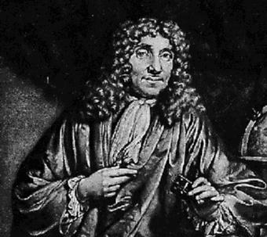
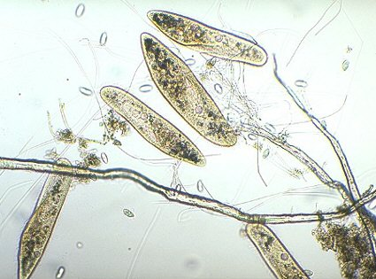
Anton van Leeuwenhoek
1673- Used a handmade microscope to observe pond scum & discovered single-celled organisms
He called them “animalcules”
He also observed blood cells from fish, birds, frogs, dogs, and humans
Van Leeuwenhoek realized that cells are found in animals as well as plants
Notes:
32

Slide 33
The Cell Theory Complete
The 3 Basic Components of the Cell Theory were now complete:
All organisms are composed of one or more cells. (Schleiden & Schwann) (1838-39)
The cell is the basic unit of life in all living things. (Schleiden & Schwann) (1838-39)
All cells are produced by the division of preexisting cells. (Virchow) (1858)
Notes:
33

Slide 34
Modern Cell Theory
Modern Cell Theory contains 4 statements, in addition to the original Cell Theory:
The cell contains hereditary information(DNA) which is passed on from cell to cell during cell division.
All cells are basically the same in chemical composition and metabolic activities.
All basic chemical & physiological functions are carried out inside the cells.(movement, digestion,etc)
Cell activity depends on the activities of sub-cellular structures within the cell(organelles, nucleus, plasma membrane)
Notes:
34

Slide 35
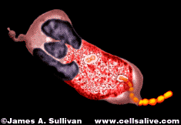
How Has The Cell Theory Been Used?
The basic discovered truths about cells, listed in the Cell Theory, are the basis for things such as:
Disease/Health/Medical Research and Cures(AIDS, Cancer, Vaccines, Cloning, Stem Cell Research, etc.)
Notes:
35

Slide 36
CELL PROJECT
The cell is the basic unit of all living things. Please complete ONE of the following projects to reinforce our study of cell structure and function. Be prepared to describe your work to the class on the day the project is due. Final project must be turned in on or before ____________.
The options are on the Cell Project Handout.

Slide 37
CELL PROJECT RUBRIC

Slide 38
Do Now
How do plants get energy?
Pair up with a peer and sort leaves into categories based on common traits.

Slide 39
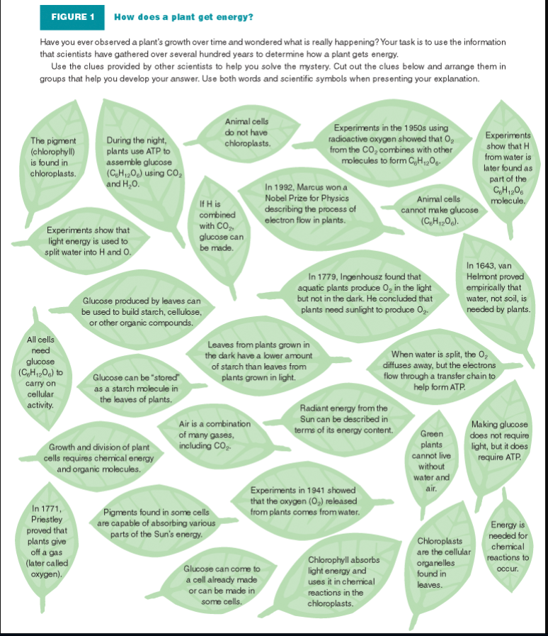

Slide 40
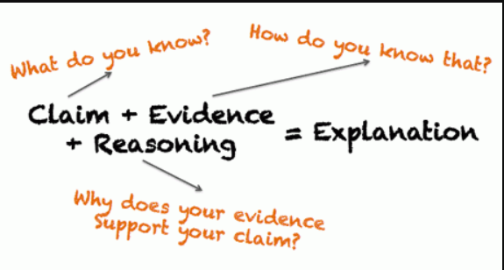

Slide 41
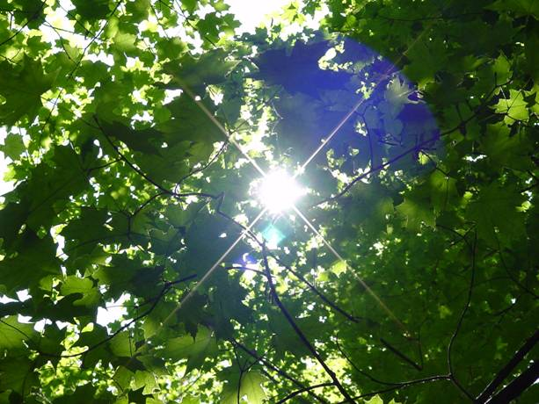
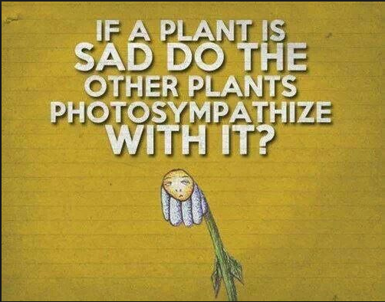
Cell Energy: Photosynthesis & Respiration

Slide 42
Today’s Learning Goals
In plants, chlorophyll (found in chloroplasts) captures energy from the sun in order to make food during photosynthesis
Cells release energy from food through either cellular respiration or fermentation
Why it matters: Understanding how plants & animals get energy to grow & develop is an important part of biology.

Slide 43
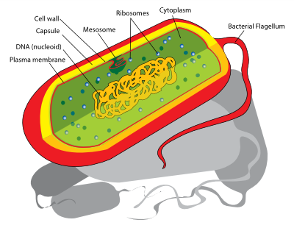
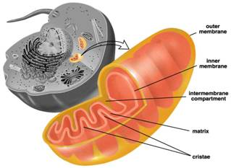
Cellular Respiration
Cellular Respiration = chemical process that happens in cells
In prokaryotes, it happens in the cell membranes
In eukaryotes, it happens mostly in the mitochondria

Slide 44
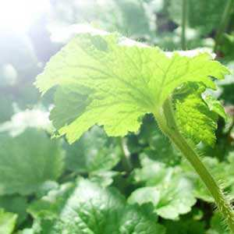
Photosynthesis
Plants make sugar from sunlight.
Light energy is turned into chemical energy (sugars are carbon based).
Copyright © 2010 Ryan P. Murphy

Slide 45
What “Food” do Plants Make?
The “food” plants make is a sugar called glucose (C₆H₁₂O₆).
Glucose and oxygen (O₂) are made during photosynthesis.

Slide 46
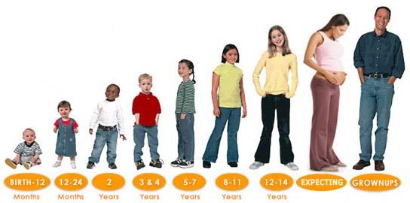
How Do Organisms Get Energy From Food?
Animals cannot make their own food like plants can.
But, BOTH plants and animals must break down (digest) food in order to get energy from it (so they can live, grow, & develop)
Cells do this 2 ways: cellular respiration and fermentation

Slide 47
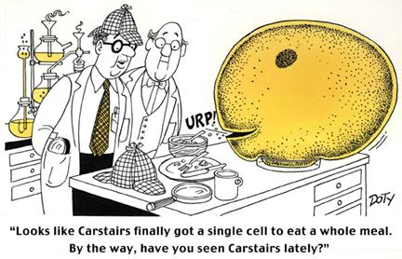
Cellular Respiration & Fermentation
Cellular Respiration uses oxygen (O₂) to break down food
Fermentation does not use oxygen
Cellular respiration releases more energy from food than Fermentation.
So most eukaryotes (ex: plants & animals) get their energy through cellular respiration

Slide 48
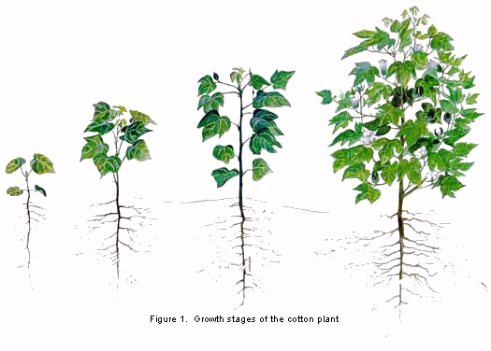
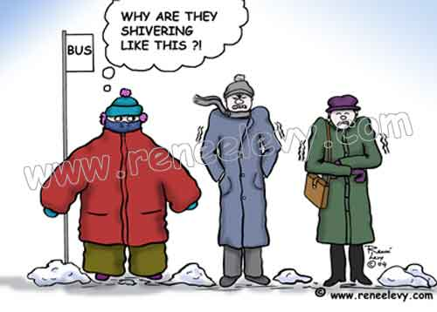
Process of Cellular Respiration
Food (glucose) is broken down into CO₂ and H₂O and energy is released
C₆H₁₂O₆ + 6 O₂ → 6 CO₂ + 6 H₂O + energy (ATP)
This energy can be used for:
Keeping a constant body temperature
Storage (ATP) - to be used later for things like growth

Slide 49
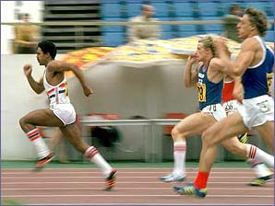
Fermentation
Happens when cells cannot get the oxygen they need for cellular respiration
Fermentation is a way to get energy when oxygen isn’t available
Ex: In short, fast races you might get a burning feeling in you leg muscles because of a build up of lactic acid (made during fermentation)

Slide 50
What Do You Notice?

Slide 51
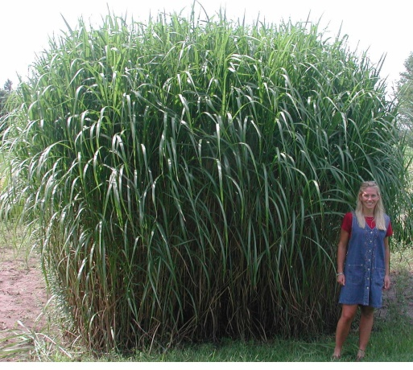
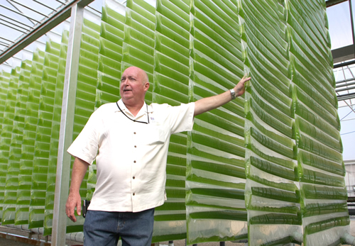
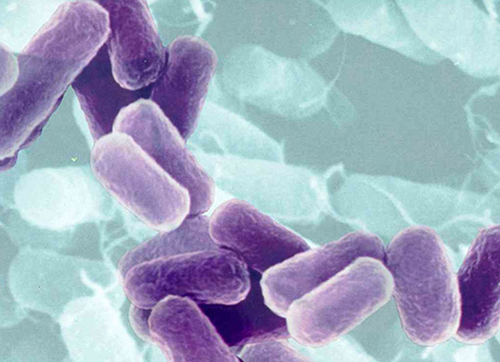
Next Generation Biofuels
Notes:
Introduction: When folks think about biofuels they often think about corn ethanol or waste grease biodiesel but there are actually many different types of biofuels. Each type of biofuel has its advantages and disadvantages. Research into biofuels has advanced very rapidly over the past few years with many of the challenges of early biofuel types being solved or traded for new challenges. Today we will review the different advancements that have been made in biofuels and discuss the various new technologies that are on the horizon for next generation biofuels.

Slide 52
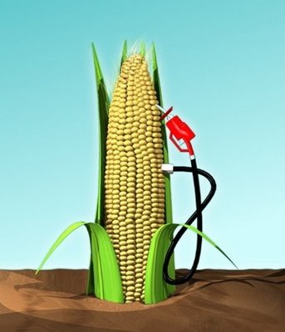
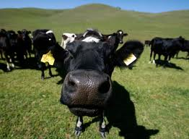
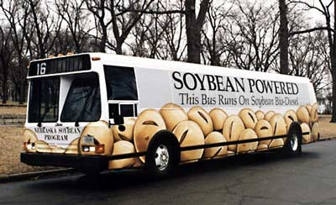
First Generation Biofuels – fuels used today
Corn Ethanol
More energy in than out
Low Yield
Competes for cropland
Heavily subsidized by government
Vegetable oil biodiesel
Compete for cropland
Low Yield
Reduces diversity in cleared areas
Biogas
Not concentrated enough
Not enough demand
http://www.etftrends.com/2010/10/corn-etfs-powered-ethanol-shift/
http://knowledge.allianz.com/
http://www.biofuels.ru/biodiesel/what_bd/
Notes:
Biofuel advancements have been described in terms of generations. This term is commonly used in the industry and by the media. First generation fuels are what we are using today. Review the disadvantages of each of these biofuels. A cow is shown for biogas because cows are a major source of methane which is the same as biogas. Cow manure can be digested and the methane trapped and used for energy.

Slide 53
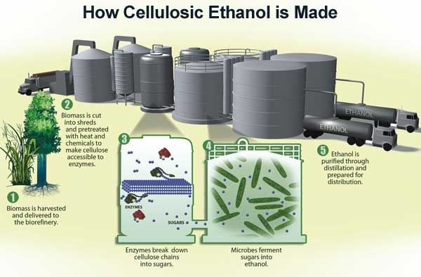
Second Generation Biofuels – fuels for tomorrow
Cellulosic Ethanol – ethanol produced from wood, grasses, or the non-edible parts of plants
Cellulose – a complex carbohydrate that supports plant structure. Most abundant naturally occurring molecule on the planet
Problems – expensive enzymes, requires fertilizers and land-use problems
http://www.aces.uiuc.edu/news/News_Photos/miscanthus2/pages/miscanthus2.html
http://energytechstocks.com/wp/?m=200804&paged=2
http://www.theresilientearth.com/?q=content/killing-biofuels
Notes:
The problem is that the enzymes (such as those shown in 3 on the figure) are expensive to make. Cellulosic ethanol is currently very expensive and not made at commercially viable scales.

Slide 54
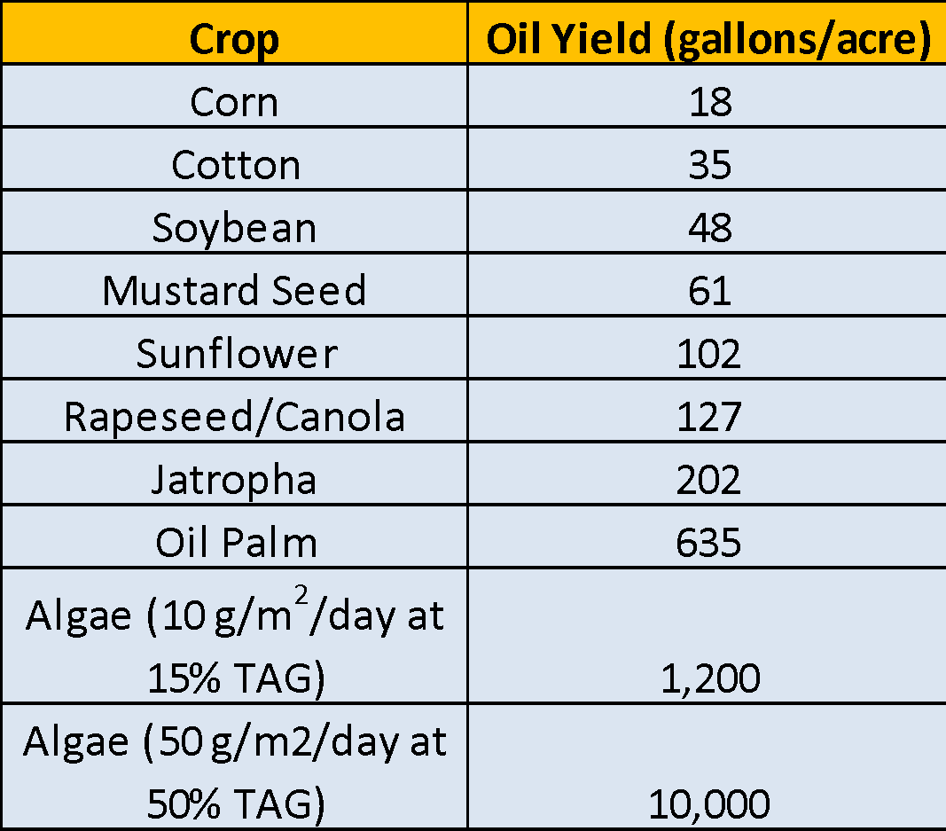
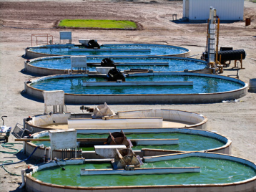
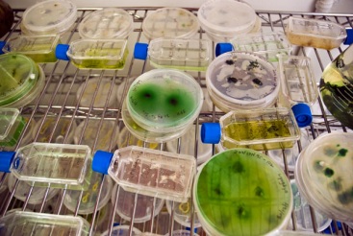
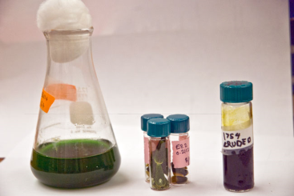
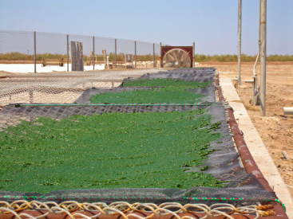
Third Generation Biofuels – fuels for the future
Algae Biofuel – ethanol or biodiesel derived from algae biomass
Advantages – Fast growing, absorbs CO₂, can use wastewater and non-arable land
Problems – Expensive to grow and harvest, contamination, unknown co-product yields
NREL
http://client-ross.com/lifecycle-workshop/docs/2.3_Attia_Sapphire_6-9-09pm.pdf
Notes:
Slide is animated. Don’t click until you ask students for examples of advantages and disadvantages. As we covered yesterday, algae biofuel offers many advantages over other biofuels. Multiple types of biofuel can be made from algae biomass. The most common is the production of biodiesel from the oils that algae make but the carbohydrates (sugars) could also be fermented into ethanol. Ask the students to offer a few advantages (fast growing, absorbs CO2, can grow on wastewater, doesn’t require arable land, diverse metabolism) click for animation and disadvantages (Expensive, we don’t know enough about lipid metabolism, not enough known about using co-products). click for animation

Slide 55
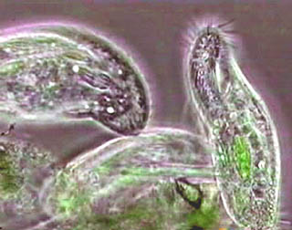
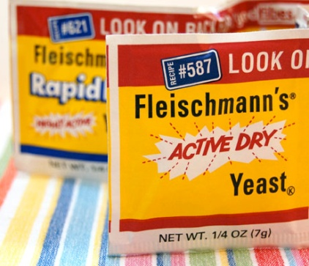
Fourth Generation Biofuels – fuels for the future
What is a microbe?
Microbes – organisms that can only be observed using a microscope such as a bacteria, fungus, protozoa or a virus (not a technical term)
Bacteria
Cyanobacteria
Yeast
Fungus
Why Use Microbes?
Easily Genetically Modified
Material for growth already in use (Fermenters)
Cyanobacteria
Bacteria
Protozoa
Yeast
Notes:
Engineered microbes are already used for a variety of industrial processes (making pharmaceuticals, alcohol fermentation). They provide many advantages over other types of systems to make biofuels. The most important advantage is that they can be relatively easily genetically modified to poduce fuels or specialty chemicals of interest. Additionally, the materials that are used to grow and manipulate microbes already exist because they have been used for other process like fermentation

